Slide 1

Cash Beta Demo Model
Presented by:
Data Science (Bhuvanesh)
22nd July 2025

Slide 2
Architecture Overview of TDB’s Risk Scorecards
For Cash Loan only
For both Cash and SIL
Limit Setting Model (Hosted in Digital Layer)
Credit Decisioning Model (Hosted in Taran)
Beta Stack
Alpha Stack
Trench 1: New Users - within 30 days from TSA Onboarding
Limit Setting Score = Gamma Stack
Beta Demo Score
Beta Demo Score
Gamma Demo Score
Apps Score
Selectively call Alpha
Apps Score
Apps Score
Credo Score
Users automatically move from Trench 1 to Trench 2 after 30 days if no disbursed loans
Credo Score
CIC Score
Gamma Income Model
Beta Income Model
Alpha Income Model
Users will stay in Trench 2 until 1st disbursed loan. His Gamma Stack will be re-calculated every 30-day anniversary from TSA onboarding date
Limit Setting Score = Gamma Stack
Beta Stack
Alpha Stack
Gamma Demo Score
Beta Demo Score
Beta Demo Score
Trench 2: Existing Users - After 30 days from TSA Onboarding AND Never Disbursed Loan
Selectively call Alpha
Apps Score
Apps Score
Apps Score
Transaction Score
Transaction Score
Transaction Score
CIC Score
Gamma Income Model
Beta Income Model
Alpha Income Model
Users will move to Trench 3 after 1st Disbursed Loan
Lowest Risk users from this B Score will be pre-approved for upsell and xsell. Medium Risk users from this B Score will have to go through Taran.
High Risk users from this B Score will not be given any offer.
B Score = Gamma Stack
Trench 3: Existing Users - After 30 days from 1st Disbursed Loan AND current DPD <= 10
Beta Stack
Alpha Stack
Gamma Demo Score
Apps Score
Beta Demo Score
Selectively call Alpha
Beta Demo Score
Apps Score
Apps Score
Enhanced Transaction Score
Enhanced Transaction Score
Once moved to Trench 3, user will forever remain in Trench 3. His Gamma Stack will be re-calculated every 30 days anniversary from 1st Loan Disbursement Date
Enhanced Transaction Score
CIC Score
Gamma Income Model
Beta Income Model
Alpha Income Model

Slide 3
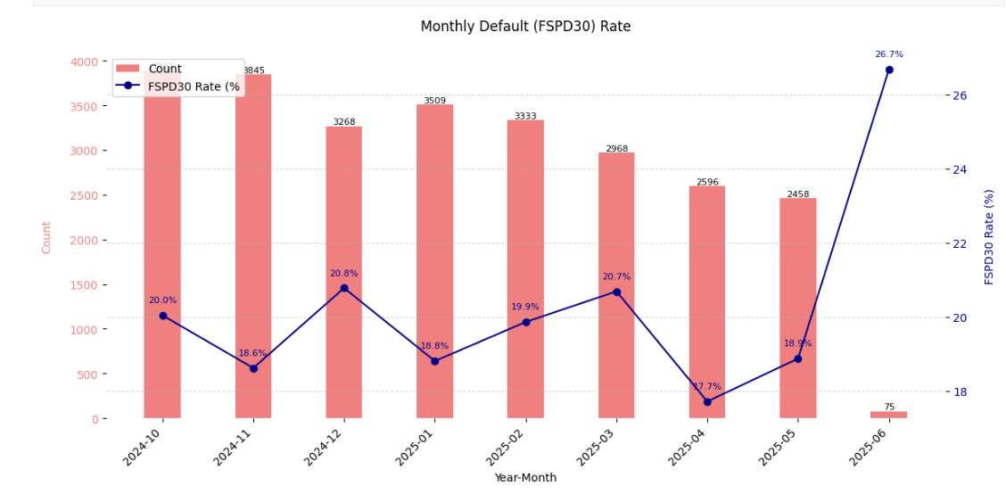
Cash Beta Demo Model: only Quick and Flex loans were considered
 | Loan Disbursement Date | # Count | # Bad (FSPD30) Quick Loans | FSPD30 rate
Training (90%) | 01/10/2024 - 31/01/2025 | 13062 | 2561 | 0.1961
Validation (10%) | 01/10/2024 - 31/01/2025 | 1452 | 274 | 0.1887
Test (Feb) | 01/02/2025 - 28/02/2025 | 3333 | 662 | 0.1986
OOT (Mar) | 01/03/2025 - 31/03/2025 | 2968 | 614 | 0.2069
OOT (Apr) | 01/04/2025 - 31/04/2025 | 2596 | 460 | 0.1772
OOT (May) | 01/05/2025 - 22/05/2025 | 2458 | 464 | 0.1888
OOT(Jun) | 01/06/2025 - 30/06/2025 | 75 | 20 | 0.2667
3

Slide 4
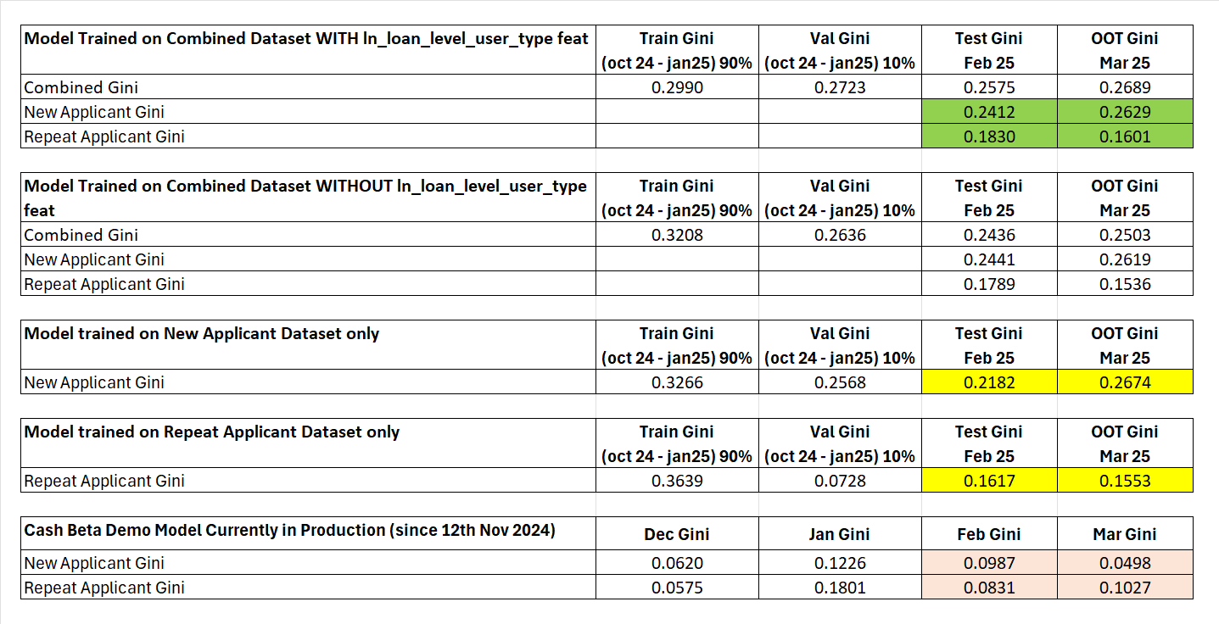
After lot of experimentations, the Model trained on combined dataset (new applicant + repeat applicant) along with the user_type feature showed the best performance and stability

Slide 5
Feature Selection Methodology Overview
Feature Selection Methodology Overview
34
Feats
25
Feats
25 Feats
25 Feats
12 Feats
IV > 0.01
Missing Rate < 95%
Inter-correlation < 75%
Individual Feature Evaluation

Slide 6
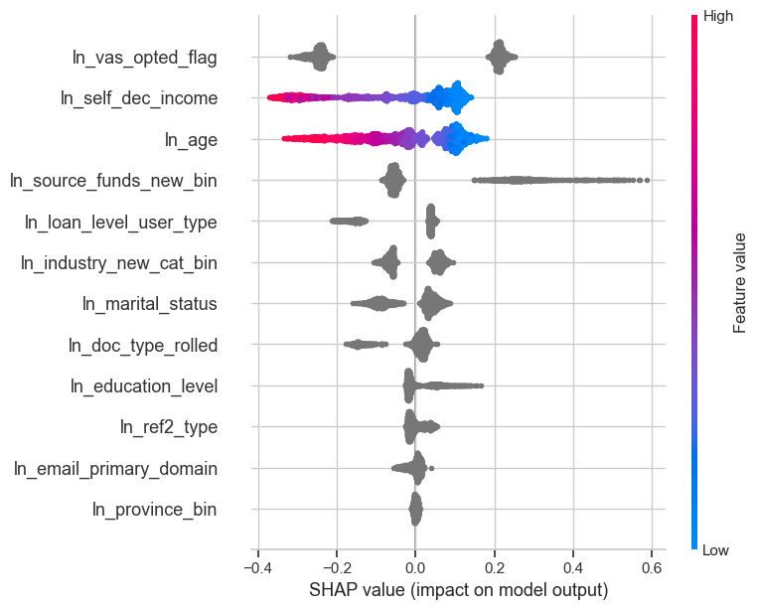
SHAP ( 12 feat )
The horizontal axis shows how much a feature affects the prediction. Points to the right mean the feature increases the prediction, and points to the left mean it decreases it.
The color of each dot shows the feature value: red means the value is high, and blue means the value is low.
If red dots are mostly on the right, it means high values of that feature increase the prediction. If red dots are on the left, high values decrease the prediction.
The features are listed on the vertical axis, from most important at the top to least important at the bottom.

Slide 7
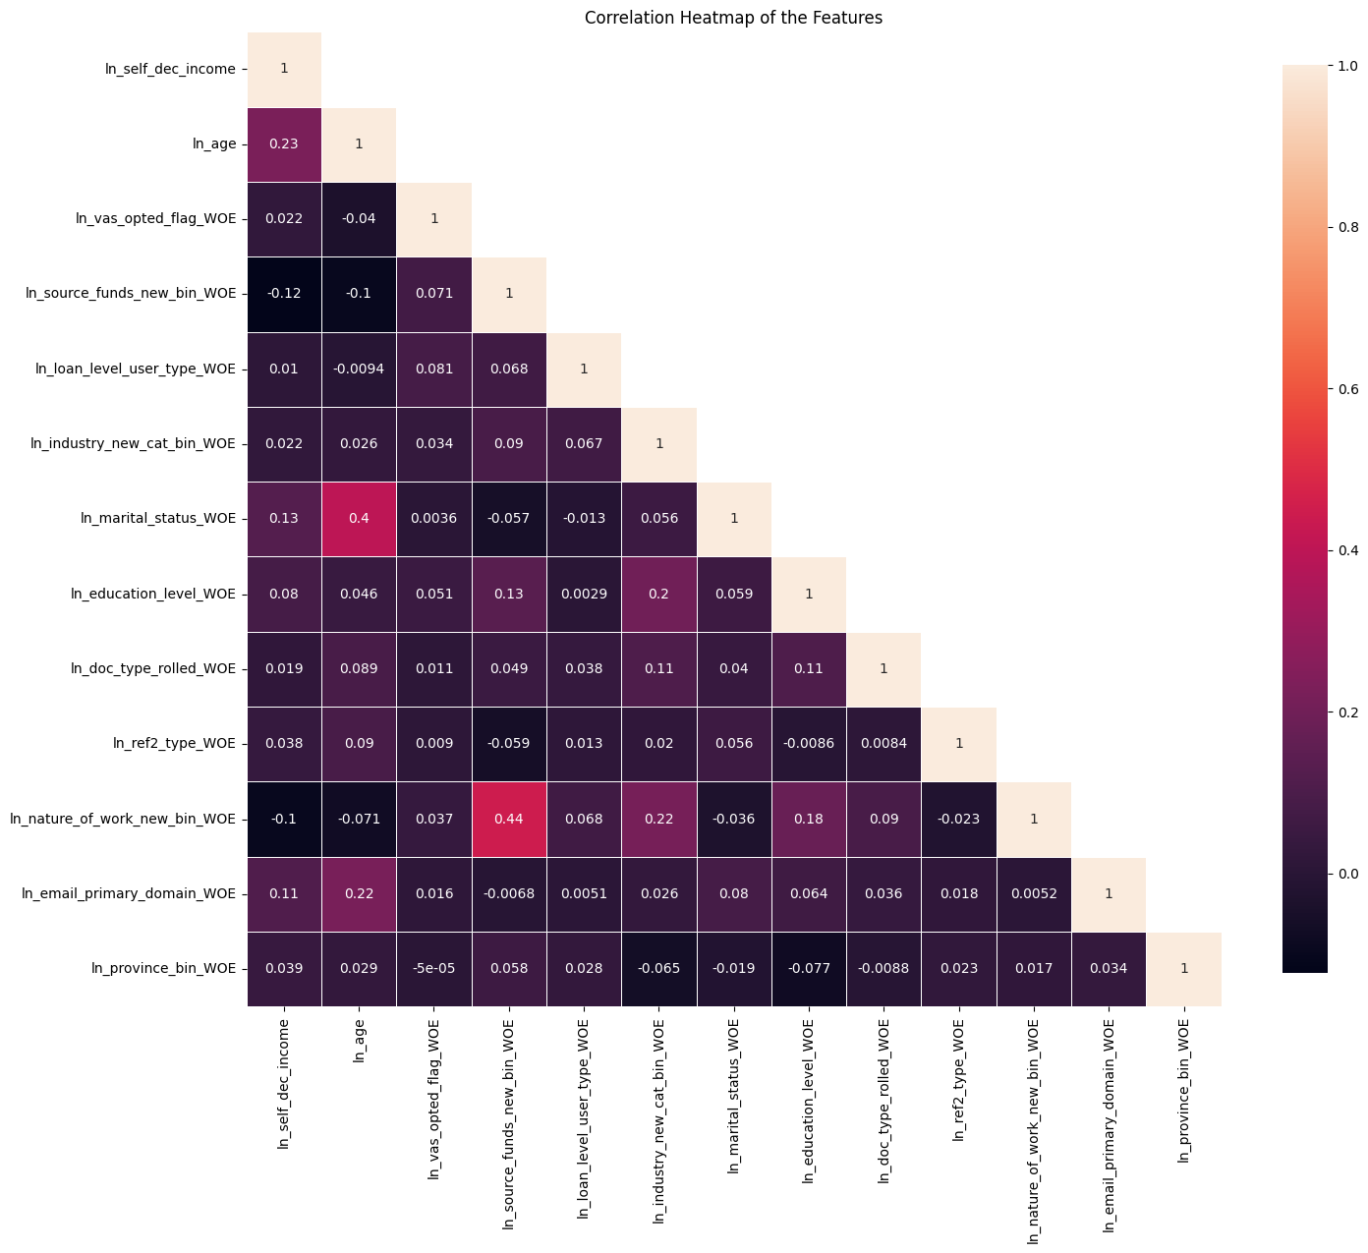
Inter-Correlation ( 12 feat )
From the correlation plot, we can see that the highest correlation is between ln_source_funds_new_bin and ln_nature_of_work_new_bin, at 44%, followed by ln_age and ln_marital_status at 40%.
These are the maximum correlations observed, and no other feature pairs show particularly high values.
The numbers in the plot indicate how strongly two features are related — values close to 1 suggest a strong positive correlation (both features increase together),
while values close to -1 imply a strong negative correlation (one increases while the other decreases).

Slide 8
Model Iteration | Features | Train (90%) Gini (Oct24 - Jan25) | Val (10%) Gini (Oct24 - Jan25) | Test Gini (Feb25) | OOT Gini (Mar25)
Model with top 1 feat | ln_vas_opted_flag | 0.1506 | 0.1627 | 0.1223 | 0.1266
Model with top 2 feat | ln_self_dec_income | 0.2203 | 0.2137 | 0.1737 | 0.1770
Model with top 3 feat | ln_age | 0.2550 | 0.2205 | 0.1967 | 0.1986
Model with top 4 feat | ln_source_funds_new_bin | 0.2753 | 0.2338 | 0.2322 | 0.2289
Model with top 5 feat | ln_loan_level_user_type | 0.2891 | 0.2502 | 0.2484 | 0.2521
Model with top 6 feat | ln_industry_new_cat_bin | 0.2955 | 0.2548 | 0.2540 | 0.2642
Model with top 7 feat | ln_marital_status | 0.3015 | 0.2612 | 0.2553 | 0.2638
Model with top 8 feat | ln_doc_type_rolled | 0.3139 | 0.2650 | 0.2594 | 0.2635
Model with top 9 feat | ln_education_level | 0.3218 | 0.2686 | 0.2587 | 0.2683
Model with top 10 feat | ln_ref2_type | 0.3178 | 0.2709 | 0.2589 | 0.2698
Model with top 11 feat | ln_email_primary_domain | 0.3272 | 0.2745 | 0.2591 | 0.2709
Model with top 12 feat | ln_province_bin | 0.3231 | 0.2728 | 0.2610 | 0.2674
12 feature model after Hyper Parameters Tuning | New + Repeat Applicant | 0.2990 | 0.2723 | 0.2575 | 0.2689
 | New Applicant | 0.2924 | 0.2677 | 0.2412 | 0.2629
 | Repeat Applicant | 0.2550 | 0.1565 | 0.1830 | 0.1601
Hyperparameter | Value
learning_rate | 0.038840875791196695
depth | 3
l2_leaf_reg | 3.1301840671498056
iterations | 2000
eval_metric | AUC
random_seed | 42
auto_class_weights | Balanced
early_stopping_rounds | 10
Hyperparameter values for the best model chosen after the HP Tuning using Optuna
8

Slide 9
SHAP Ranks are very consistent Across Training, Test and OOT Windows
feature | Train Rank (Oct'24 - Jan'25) | Test Rank (Feb'25) | OOT Rank (Mar'25)
ln_vas_opted_flag | 1 | 1 | 1
ln_self_dec_income | 2 | 2 | 2
ln_age | 3 | 3 | 3
ln_source_funds_new_bin | 4 | 4 | 4
ln_loan_level_user_type | 5 | 5 | 5
ln_industry_new_cat_bin | 6 | 6 | 6
ln_marital_status | 7 | 7 | 7
ln_doc_type_rolled | 8 | 8 | 8
ln_education_level | 9 | 9 | 9
ln_ref2_type | 10 | 10 | 10
ln_email_primary_domain | 11 | 11 | 11
ln_province_bin | 12 | 12 | 12
9

Slide 10
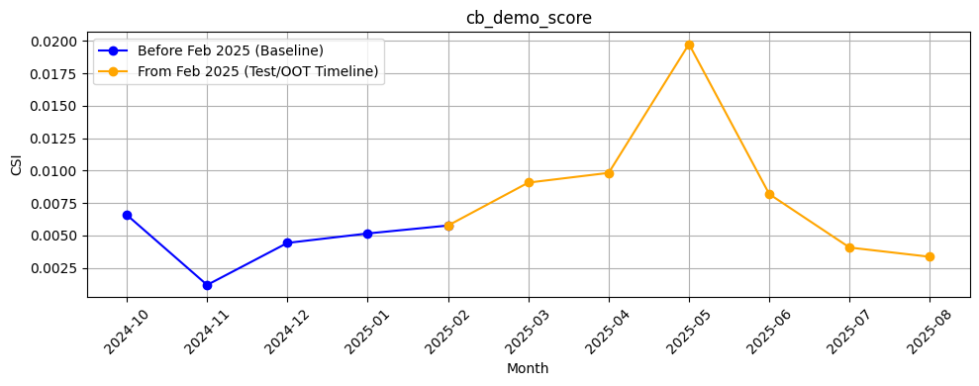
M-O-M Model PSI values (Baseline Training period) - Overall Applied
10

Slide 11
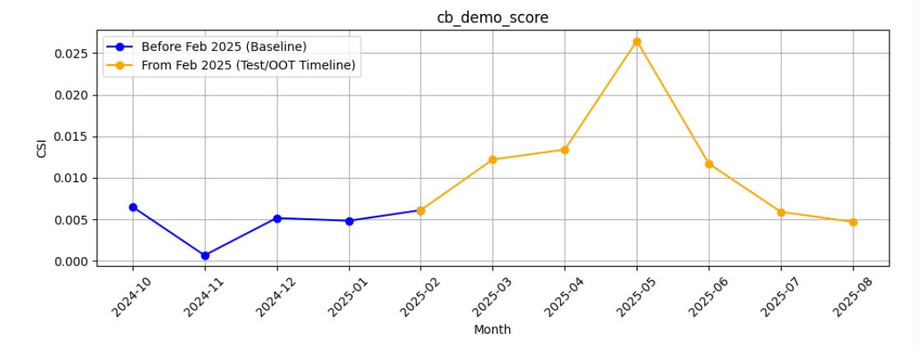
M-O-M Model PSI values (Baseline Training period) - Android Applied
11

Slide 12
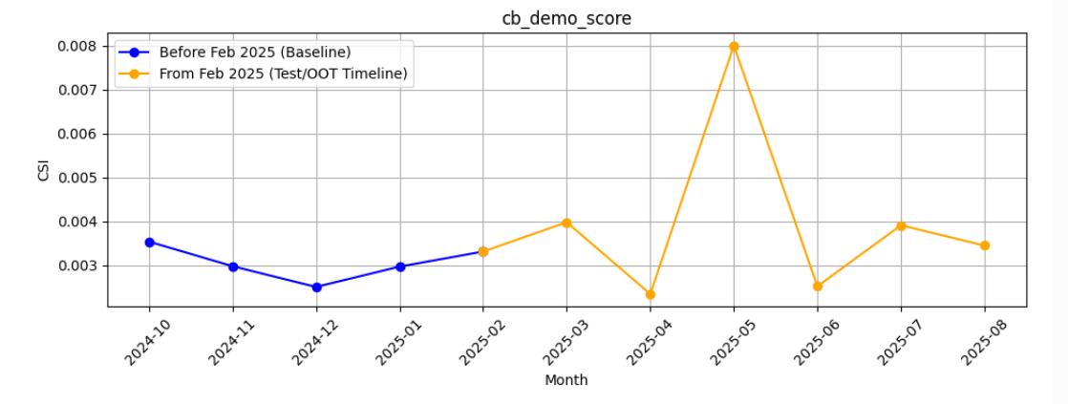
M-O-M Model PSI values (Baseline Training period) - iOS Applied
12

Slide 13
Feature Description
Feature Name | Feature Description
ln_vas_opted_flag | Indicates whether the user has opted for any value-added services, such as PayHinga (payment holiday feature).
ln_self_dec_income | Self declared income of customer.
ln_age | Age of the loan applicant
ln_source_funds_new_cat | Different sources of a person’s income.
ln_loan_level_user_type | It represents user type whether a new or repeat (repeat if the customer had any disbursed loans in the past with Tonik else new)
ln_industry_new_cat_bin | Type of industry in which loan applicant is employed.
ln_marital_status | Marital status of the loan applicant.
ln_doc_type_rolled | Type of identification document provided by the loan applicant.
ln_education_level | Highest Education Level of loan applicant.
ln_ref2_type | Relationship of the second reference person to the individual (e.g., sibling, friend, spouse).
ln_email_primary_domain | Domain from the primary email address of the user.
ln_province_bin | It indicates the applicant's declared province of residence during the loan application.
13

Slide 14
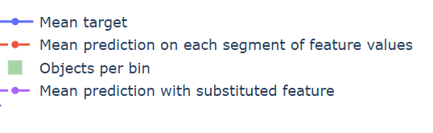
Feature Stability Plot Legend Table
Symbol / Line | Name | What It Shows | How to Interpret
🔷 Blue Line | Mean Target | Average true target (e.g., default rate) in each bin of the feature | 📈 Spiky → Target is unstable or noisy 📉 Smooth → Target changes consistently
🔴 Red Dashed Line | Mean Prediction | Model's average predicted score in each bin | Should generally follow blue line Slightly smoother → Model generalizes to avoid overfitting
🟩 Green Bars | Objects per Bin | Count of data points in each bin | High = reliable signal ⚠️ Very low = sparse data = risk of overfitting or unreliable predictions
🟣 Purple Dotted Line | Mean Prediction with Substituted Feature | Prediction if this feature was shuffled or replaced randomly | Closer to red = model doesn’t rely much on feature Further from red = model depends heavily on feature
14

Slide 15
Feature Evaluation Plots (12 features)

Slide 16
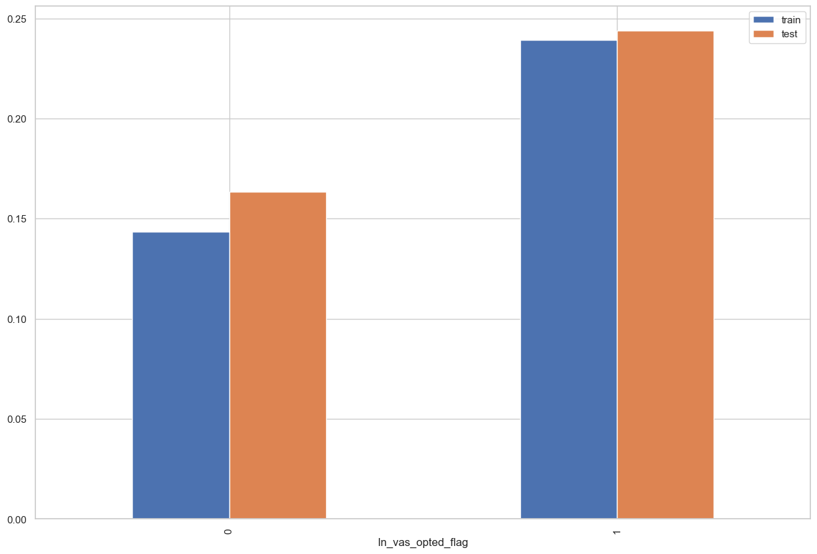
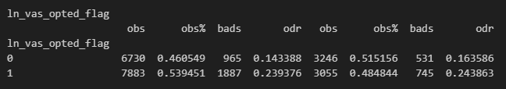
Rank# 1: ln_vas_opted_flag ( 1 / 5 ) - Feature Performance in Train vs Test <Disbursed>
Indicates whether the user has opted for any value-added services, such as PayHinga (payment holiday feature).

Slide 17
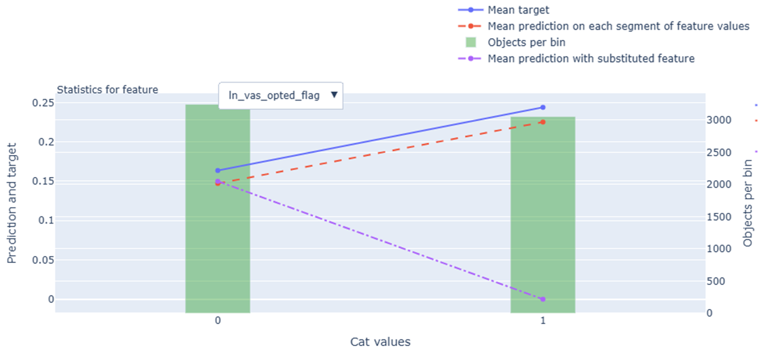
Rank# 1: ln_vas_opted_flag ( 2 / 5 ) - Feature Statistics Analysis <Disbursed>
The red line (model prediction) follows the blue line (actual target), showing the model is using this feature effectively.
There is a visible gap between the red and purple lines, which means the feature is helping the model make better predictions.
The green bars (data per bin) are balanced, with slightly more records in category 0 than 1.
The target rate increases with value 1, highlighting a positive relationship with the target.
17

Slide 18
Rank# 1: ln_vas_opted_flag ( 3 / 5 ) - MoM Feature Distribution <Applied>
ln_vas_opted_flag | Applied Count | Approval Rate | 1 | 0 |  | Avg. Demo Score
2024-10 | 50,582 | 7.9% | 72.8% | 27.2% |  | 0.561049
2024-11 | 45,564 | 8.4% | 71.1% | 28.9% |  | 0.557048
2024-12 | 37,904 | 8.7% | 70.4% | 29.6% |  | 0.548927
2025-01 | 41,196 | 8.6% | 68.1% | 31.9% |  | 0.548719
2025-02 | 43,277 | 7.7% | 65.9% | 34.1% |  | 0.548875
2025-03 | 36,089 | 8.0% | 65.0% | 35.0% |  | 0.546775
2025-04 | 36,182 | 7.2% | 65.4% | 34.6% |  | 0.545994
2025-05 | 34,393 | 8.0% | 65.1% | 34.9% |  | 0.542096
2025-06 | 42,285 | 7.7% | 66.3% | 33.7% |  | 0.546284
2025-07 | 42,637 | 7.2% | 67.3% | 32.7% |  | 0.549238
2025-08 | 39,958 | 7.6% | 67.4% | 32.6% |  | 0.550130
The share of users opting in (value = 1) declines gradually from 72.8% in Oct 2024 to 66.3% in Jun 2025, showing a smooth transition.
The non-opted group (value = 0) increases steadily from 27.2% to 33.7%, indicating a balanced distribution shift.
There are no sudden spikes or drops, reflecting a stable and reliable month-on-month trend in user preferences.
18

Slide 19
Rank# 1: ln_vas_opted_flag ( 4 / 5 ) - MoM Feature Distribution <Applied> <User Type wise>
New Applicant
ln_vas_opted_flag | Applied Count | Approval Rate | 1 | 0 |  | Avg. Demo Score
2024-10 | 48,679 | 7.0% | 73.5% | 26.5% |  | 0.564780
2024-11 | 43,517 | 7.5% | 71.9% | 28.1% |  | 0.561230
2024-12 | 34,606 | 7.0% | 71.8% | 28.2% |  | 0.556868
2025-01 | 37,704 | 6.9% | 69.5% | 30.5% |  | 0.556664
2025-02 | 39,881 | 6.4% | 67.2% | 32.8% |  | 0.556129
2025-03 | 32,281 | 6.1% | 66.7% | 33.3% |  | 0.556870
2025-04 | 32,359 | 5.3% | 67.1% | 32.9% |  | 0.555703
2025-05 | 30,492 | 5.8% | 66.9% | 33.1% |  | 0.552444
2025-06 | 37,846 | 5.9% | 67.7% | 32.3% |  | 0.555536
2025-07 | 38,034 | 5.3% | 68.9% | 31.1% |  | 0.559003
2025-08 | 36,000 | 5.0% | 68.8% | 31.2% |  | 0.559164
Repeat Applicant
ln_vas_opted_flag | Applied Count | Approval Rate | 1 | 0 |  | Avg. Demo Score
2024-10 | 1,903 | 31.1% | 53.7% | 46.3% |  | 0.465621
2024-11 | 2,047 | 27.0% | 54.3% | 45.7% |  | 0.468136
2024-12 | 3,298 | 26.4% | 55.2% | 44.8% |  | 0.465606
2025-01 | 3,492 | 26.2% | 53.1% | 46.9% |  | 0.462927
2025-02 | 3,396 | 23.2% | 51.1% | 48.9% |  | 0.463683
2025-03 | 3,808 | 24.6% | 50.6% | 49.4% |  | 0.461201
2025-04 | 3,823 | 23.1% | 51.6% | 48.4% |  | 0.463816
2025-05 | 3,901 | 25.7% | 50.9% | 49.1% |  | 0.461210
2025-06 | 4,439 | 23.6% | 54.2% | 45.8% |  | 0.467403
2025-07 | 4,603 | 23.1% | 54.2% | 45.8% |  | 0.468555
2025-08 | 3,958 | 31.5% | 54.6% | 45.4% |  | 0.467967
The share of users opting in (value = 1) among new applicants shows a gradual decline from 73.5% in Oct 2024 to 67.7% in Jun 2025, indicating a steady reduction in opt-in behavior over time.
The non-opted group (value = 0) increases from 26.5% to 32.3%, reflecting a modest but consistent shift in user preference.
The transition is smooth, with no abrupt changes, suggesting a stable month-on-month trend in VAS choices among new applicants.
For repeat applicants, the VAS opt-in share fluctuates slightly but remains in a narrow range—from 53.7% in Oct 2024 to 54.2% in Jun 2025. This indicates a largely stable opt-in behavior over the months.
The non-opted group (value = 0) also shows minor variation, ranging from 46.3% to 45.8%, with no significant upward or downward trend.
Overall, the distribution reflects a consistently balanced preference in VAS opt-in status among repeat applicants, without notable shifts.
19

Slide 20
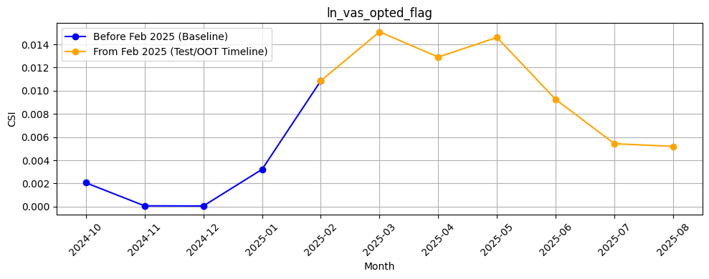
Rank# 1: ln_vas_opted_flag ( 5 / 5 ) - Feature CSI Analysis <Applied>
Here the baseline data considered is Oct’2024 to Jan’2025.
CSI remained well below 0.1 throughout the training period (Oct 2024 to Jan 2025), showing strong feature stability.
During the Test/OOT period (Feb to Jun 2025), CSI values peaked around 0.015 — far below the 0.1 threshold — confirming that ‘ln_vas_opted_flag’ remains stable and does not exhibit any meaningful data drift.

Slide 21
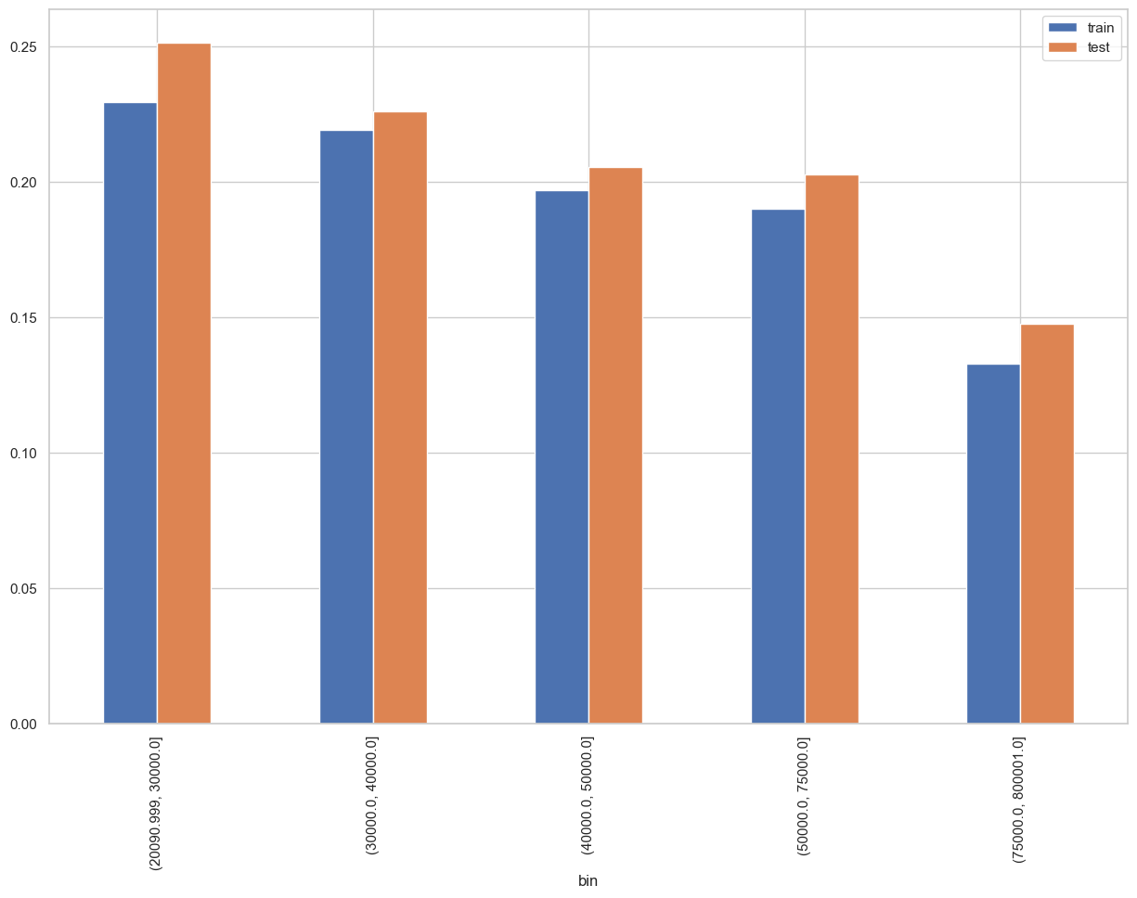
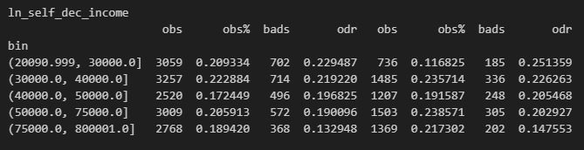
Rank# 2: ln_self_dec_income ( 1 / 6 ) - Feature Performance in Train vs Test <Disbursed>
Self declared income of customer.
Please note these are just WOE Bins, NOT the final Bins that Catboost chooses internally

Slide 22
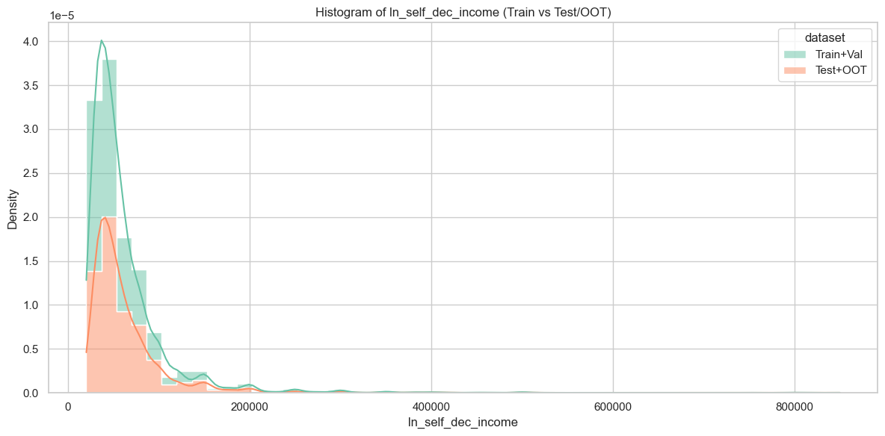
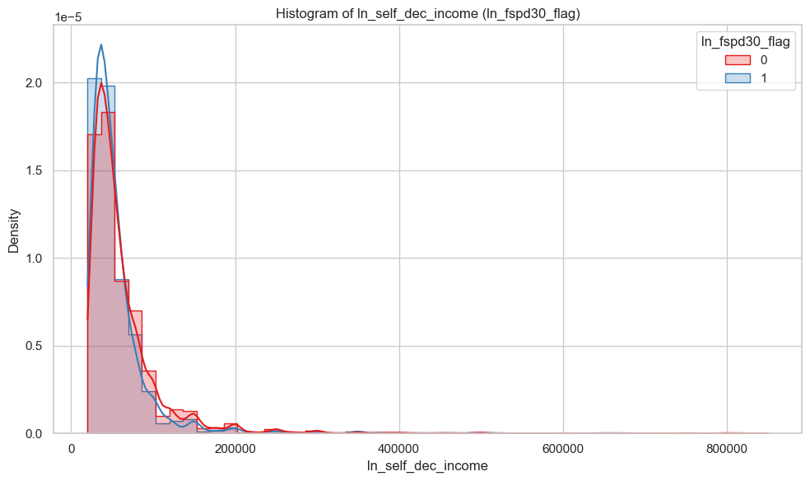
Rank# 2: ln_self_dec_income ( 2 / 6 ) - Histogram <Disbursed>
Most customers, whether good or bad, have low to moderate self-declared incomes. However, as income increases, the number of bad customers (blue line) becomes noticeably fewer. This suggests that customers who report higher incomes are less likely to be bad.
Both datasets (Train+Val and Test+OOT) show a similar income distribution, with most customers concentrated in the low-income range. The Test+OOT set (orange) has slightly fewer high-income records but overall follows the same trend as the Train+Val set (green), indicating good consistency across datasets.

Slide 23
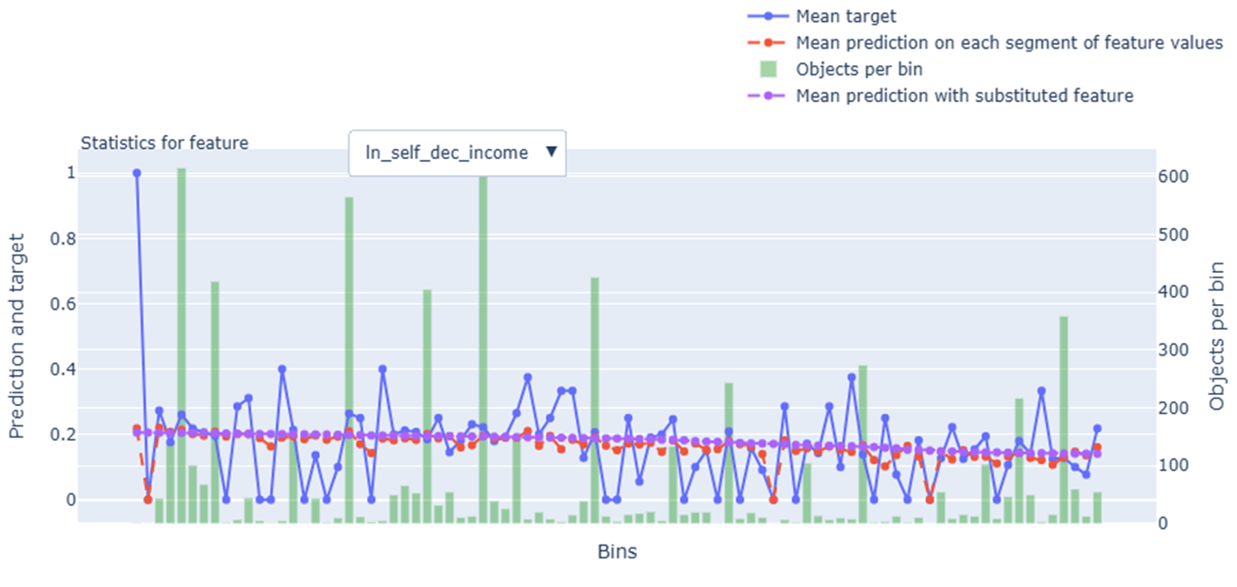
Rank# 2: ln_self_dec_income ( 3 / 6 ) - Feature Statistics Analysis <Disbursed>
The red line (model prediction) mostly follows the same trend as the blue line (actual target), showing the model is using this feature effectively.
There is a modest gap between the red and purple lines, indicating the feature contributes to better predictions.
The green bars (data per bin) show good distribution across income levels, though some bins have fewer samples.
The target rate shows a mild downward trend with higher income, making this a useful feature for the model.

Slide 24
Rank# 2: ln_self_dec_income ( 4 / 6 ) - MoM Mean Distribution <Applied>
ln_self_dec_income | Applied Count | Approval Rate | Mean |  | Avg. Demo Score
2024-10 | 50,582 | 7.9% | 30,595 |  | 0.561049
2024-11 | 45,564 | 8.4% | 32,212 |  | 0.557048
2024-12 | 37,904 | 8.7% | 34,697 |  | 0.548927
2025-01 | 41,196 | 8.6% | 33,682 |  | 0.548719
2025-02 | 43,277 | 7.7% | 33,058 |  | 0.548875
2025-03 | 36,089 | 8.0% | 33,604 |  | 0.546775
2025-04 | 36,182 | 7.2% | 33,272 |  | 0.545994
2025-05 | 34,393 | 8.0% | 34,354 |  | 0.542096
2025-06 | 42,285 | 7.7% | 33,810 |  | 0.546284
2025-07 | 42,637 | 7.2% | 33,320 |  | 0.549238
2025-08 | 39,958 | 7.6% | 32,867 |  | 0.550130
The mean self-declared income increases steadily from 30,595 in Oct 2024 to ~34,000+ in later months, indicating a gradual and consistent upward trend.
From Dec 2024 onward, the values stabilize, fluctuating within a narrow band of ~33,000–34,700, showing good distributional consistency.
The smooth trend and lack of sharp jumps or drops reflect strong feature stability over time, making it reliable for modeling.

Slide 25
Rank# 2: ln_self_dec_income ( 5 / 6 ) - MoM Mean Distribution <Applied> <User Type wise>
New Applicant
ln_self_dec_income | Applied Count | Approval Rate | Mean |  | Avg. Demo Score
2024-10 | 48,679 | 7.0% | 30,194 |  | 0.564780
2024-11 | 43,517 | 7.5% | 31,730 |  | 0.561230
2024-12 | 34,606 | 7.0% | 33,811 |  | 0.556868
2025-01 | 37,704 | 6.9% | 32,922 |  | 0.556664
2025-02 | 39,881 | 6.4% | 32,347 |  | 0.556129
2025-03 | 32,281 | 6.1% | 32,579 |  | 0.556870
2025-04 | 32,359 | 5.3% | 32,088 |  | 0.555703
2025-05 | 30,492 | 5.8% | 33,034 |  | 0.552444
2025-06 | 37,846 | 5.9% | 32,810 |  | 0.555536
2025-07 | 38,034 | 5.3% | 32,174 |  | 0.559003
2025-08 | 36,000 | 5.0% | 31,846 |  | 0.559164
Repeat Applicant
ln_self_dec_income | Applied Count | Approval Rate | Mean |  | Avg. Demo Score
2024-10 | 1,903 | 31.1% | 40,842 |  | 0.465621
2024-11 | 2,047 | 27.0% | 42,468 |  | 0.468136
2024-12 | 3,298 | 26.4% | 43,986 |  | 0.465606
2025-01 | 3,492 | 26.2% | 41,886 |  | 0.462927
2025-02 | 3,396 | 23.2% | 41,406 |  | 0.463683
2025-03 | 3,808 | 24.6% | 42,287 |  | 0.461201
2025-04 | 3,823 | 23.1% | 43,296 |  | 0.463816
2025-05 | 3,901 | 25.7% | 44,677 |  | 0.461210
2025-06 | 4,439 | 23.6% | 42,334 |  | 0.467403
2025-07 | 4,603 | 23.1% | 42,794 |  | 0.468555
2025-08 | 3,958 | 31.5% | 42,154 |  | 0.467967
Income shows a gradual and stable trend, rising moderately from Oct 2024 to Dec, then stabilizing.
Month-to-month changes are smooth, indicating a consistently distributed pattern.
Income remains consistently high with a steady upward trend through most months.
No sharp fluctuations, reflecting a stable and reliable distribution.

Slide 26
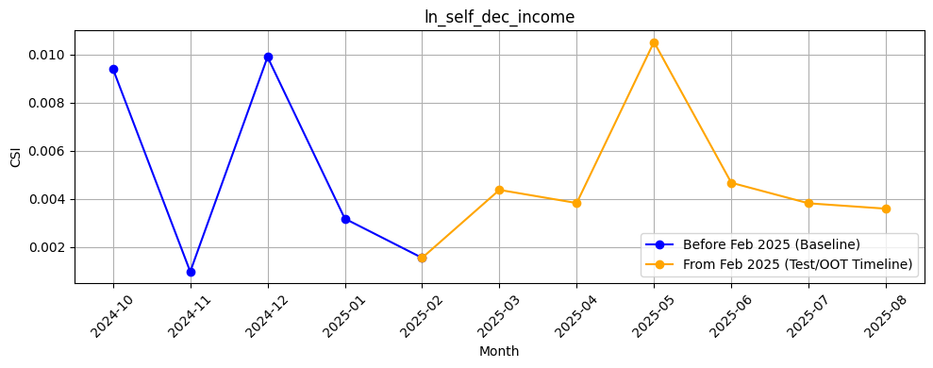
Rank# 2: ln_self_dec_income ( 6 / 6 ) - Feature CSI Analysis <Applied>
Here the baseline data considered is Oct’2024 to Jan’2025.
During the training period (Oct 2024 to Jan 2025), CSI values stayed well below 0.01, indicating strong consistency and no signs of data drift.
In the Test/OOT period (Feb to Jun 2025), CSI remained low — peaking slightly in May but still under 0.012 — which is far below the 0.1 threshold, confirming the feature is stable and reliable over time.

Slide 27
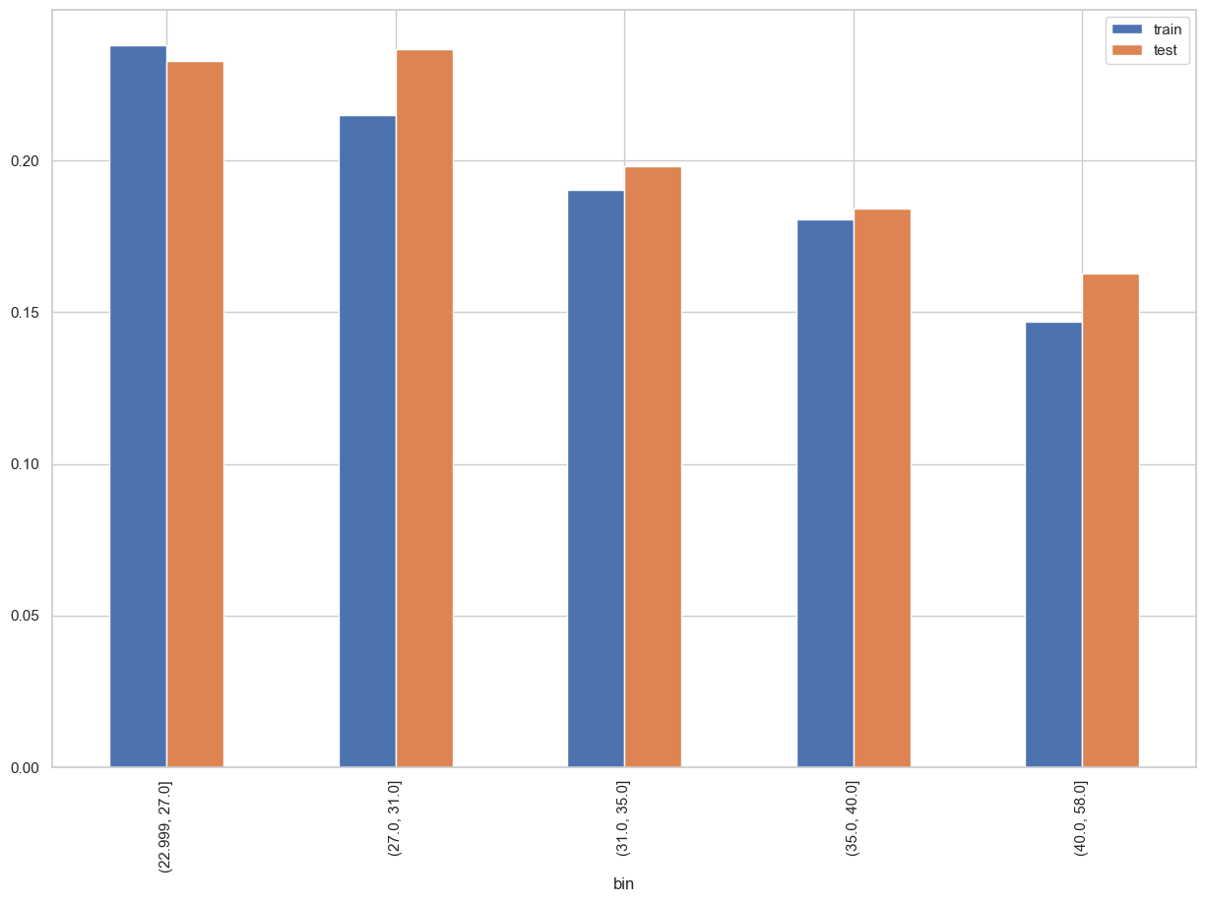
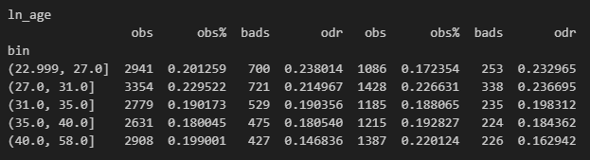
Rank# 3: ln_age ( 1 / 6 ) - Feature Performance in Train vs Test <Disbursed>
Age of the loan applicant/customer
27
Please note these are just WOE Bins, NOT the final Bins that Catboost chooses internally

Slide 28
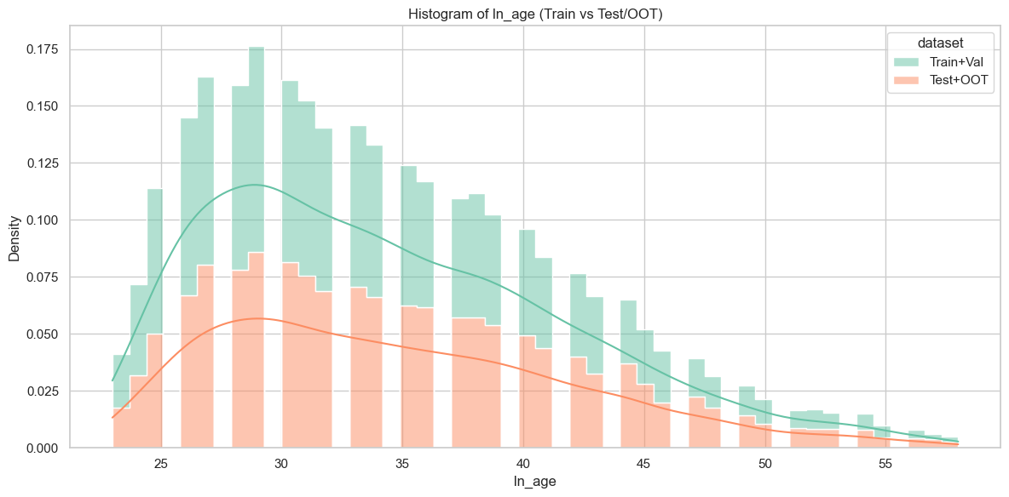
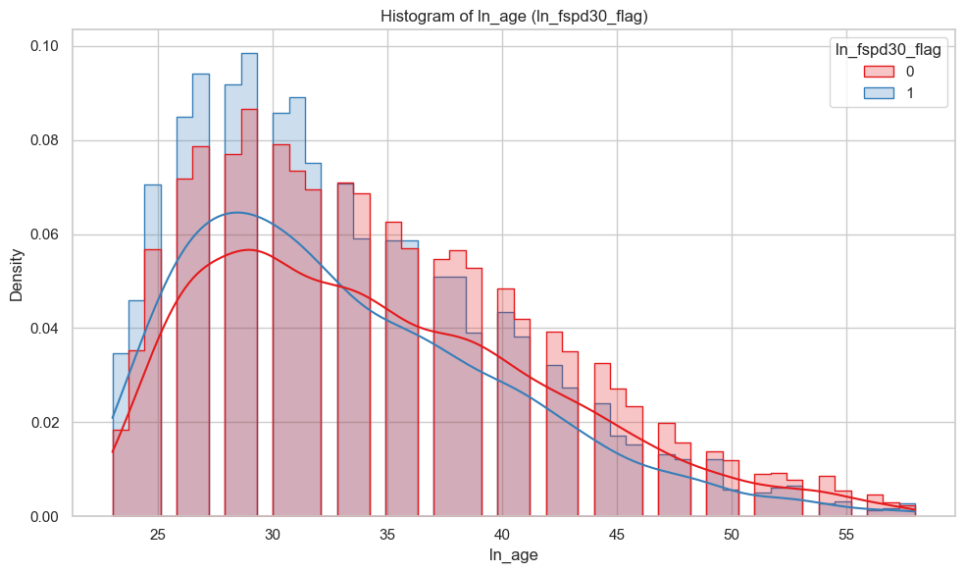
Rank# 3: ln_age ( 2 / 6 ) - Histogram <Disbursed>
Most customers, both good and bad, are in their late 20s to early 30s, with similar overall age distributions. However, bad customers (blue line) tend to be slightly younger on average, while good customers (red line) are more common in older age groups.
The Train+Validation set (green) has a higher concentration of younger customers, especially around the late 20s to early 30s. The Test+OOT set (orange) follows a similar pattern but with lower density across all ages, indicating fewer samples and slightly older age distribution.

Slide 29
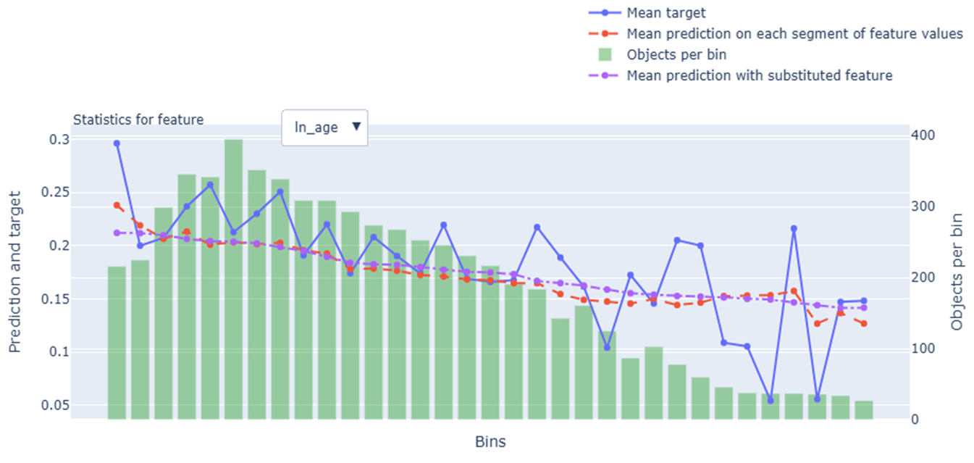
Rank# 3: ln_age ( 3 / 6 ) - Feature Statistics Analysis <Disbursed>
The red line (model prediction) generally follows the trend of the blue line (actual target), showing the model is leveraging this feature effectively.
There is a consistent gap between the red and purple lines, indicating the feature adds predictive strength to the model.
The green bars (data per bin) are well distributed, with a concentration of records in the middle-age range.
The target rate shows a clear downward trend with increasing age, making this a useful feature for the model.

Slide 30
Rank# 3: ln_age ( 4 / 6 ) - MoM Mean Distribution <Applied>
ln_age | Applied Count | Approval Rate | Mean |  | Avg. Demo Score
2024-10 | 50,582 | 7.9% | 31.6 |  | 0.561049
2024-11 | 45,564 | 8.4% | 31.7 |  | 0.557048
2024-12 | 37,904 | 8.7% | 32.3 |  | 0.548927
2025-01 | 41,196 | 8.6% | 31.7 |  | 0.548719
2025-02 | 43,277 | 7.7% | 31.5 |  | 0.548875
2025-03 | 36,089 | 8.0% | 31.3 |  | 0.546775
2025-04 | 36,182 | 7.2% | 31.4 |  | 0.545994
2025-05 | 34,393 | 8.0% | 31.4 |  | 0.542096
2025-06 | 42,285 | 7.7% | 31.4 |  | 0.546284
2025-07 | 42,637 | 7.2% | 31.3 |  | 0.549238
2025-08 | 39,958 | 7.6% | 31.2 |  | 0.550130
The mean age remains highly stable, ranging narrowly between 31.3 and 32.3 over the entire period.
A small spike in Dec 2024 (32.3) is observed, but values quickly return to ~31.4, indicating no sustained shift.
Overall, the feature shows excellent stability month over month, making it reliable and consistent for modeling.
30

Slide 31
Rank# 3: ln_age ( 5 / 6 ) - MoM Mean Distribution <Applied> <User Type wise>
New Applicant
ln_age | Applied Count | Approval Rate | Mean |  | Avg. Demo Score
2024-10 | 48,679 | 7.0% | 31.5 |  | 0.564780
2024-11 | 43,517 | 7.5% | 31.6 |  | 0.561230
2024-12 | 34,606 | 7.0% | 32.2 |  | 0.556868
2025-01 | 37,704 | 6.9% | 31.5 |  | 0.556664
2025-02 | 39,881 | 6.4% | 31.3 |  | 0.556129
2025-03 | 32,281 | 6.1% | 30.9 |  | 0.556870
2025-04 | 32,359 | 5.3% | 31.0 |  | 0.555703
2025-05 | 30,492 | 5.8% | 31.0 |  | 0.552444
2025-06 | 37,846 | 5.9% | 31.0 |  | 0.555536
2025-07 | 38,034 | 5.3% | 30.9 |  | 0.559003
2025-08 | 36,000 | 5.0% | 30.7 |  | 0.559164
Repeat Applicant
ln_age | Applied Count | Approval Rate | Mean |  | Avg. Demo Score
2024-10 | 1,903 | 31.1% | 34.1 |  | 0.465621
2024-11 | 2,047 | 27.0% | 33.9 |  | 0.468136
2024-12 | 3,298 | 26.4% | 33.5 |  | 0.465606
2025-01 | 3,492 | 26.2% | 34.2 |  | 0.462927
2025-02 | 3,396 | 23.2% | 34.4 |  | 0.463683
2025-03 | 3,808 | 24.6% | 34.7 |  | 0.461201
2025-04 | 3,823 | 23.1% | 34.5 |  | 0.463816
2025-05 | 3,901 | 25.7% | 34.6 |  | 0.461210
2025-06 | 4,439 | 23.6% | 34.8 |  | 0.467403
2025-07 | 4,603 | 23.1% | 34.8 |  | 0.468555
2025-08 | 3,958 | 31.5% | 35.2 |  | 0.467967
Income shows a gradual and stable trend, rising moderately from Oct 2024 to Dec, then stabilizing.
Month-to-month changes are smooth, indicating a consistently distributed pattern.
Income remains consistently high with a steady upward trend through most months.
No sharp fluctuations, reflecting a stable and reliable distribution.
31

Slide 32
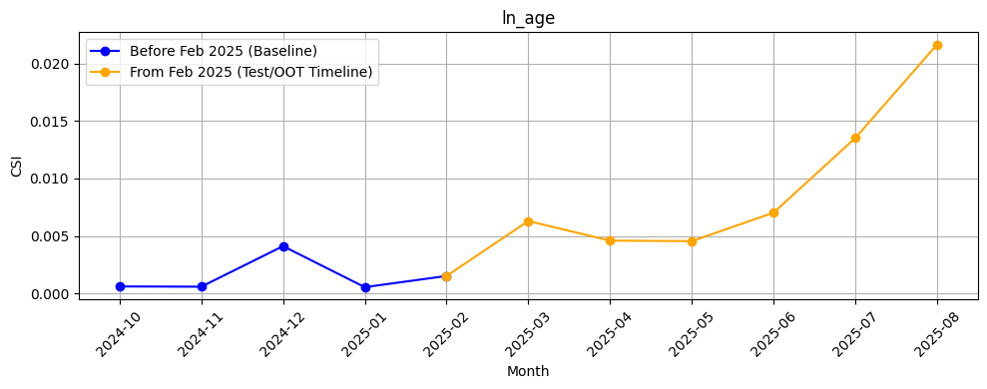
Rank# 3: ln_age ( 6 / 6 ) - Feature CSI Analysis <Applied>
Here the baseline data considered is Oct’2024 to Jan’2025.
CSI values remained very low throughout the baseline period, peaking at just over 0.004 in December 2024 and mostly staying below 0.001 in other months — indicating strong stability.
In the Test/OOT period (Feb to Jun 2025), CSI values increased modestly but consistently remained below 0.007, well under the 0.1 threshold. This confirms that the “ln_age” feature remains stable over time and shows no evidence of significant data drift.

Slide 33
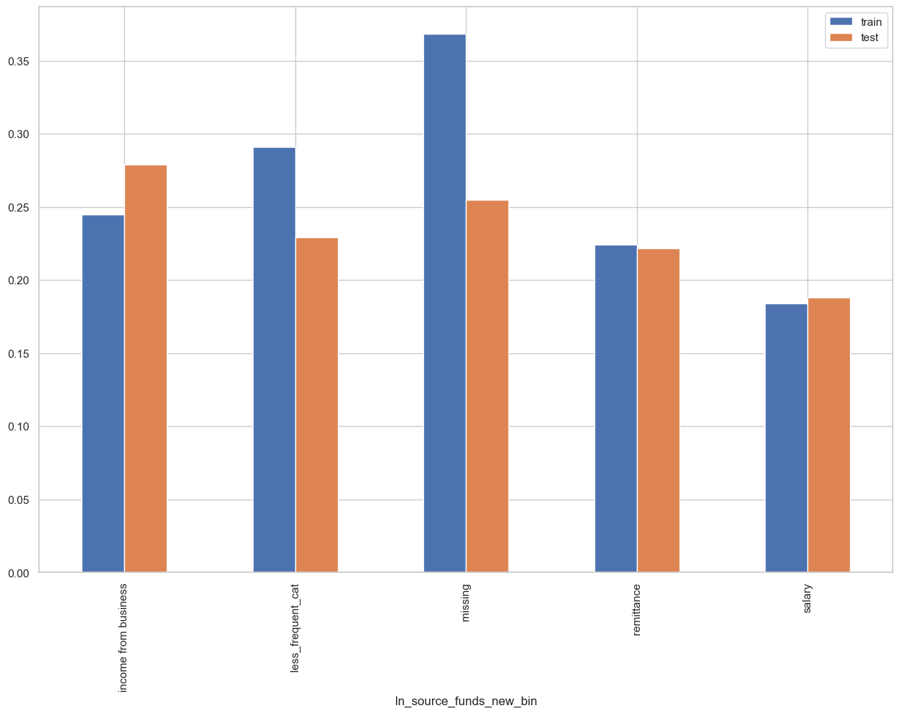
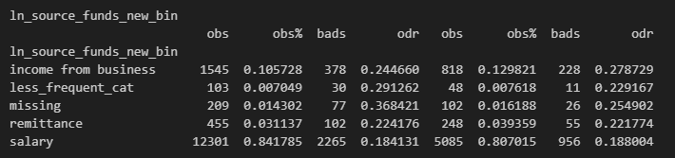
Rank# 4: ln_source_funds_new_bin ( 1 / 5 ) - Feature Performance in Train vs Test <Disbursed>
It represents different sources of a person’s income.
Less_Frequency_Cat
Allowance ,Pension, Interest on deposits and investments, Inheritance/retirement funds

Slide 34
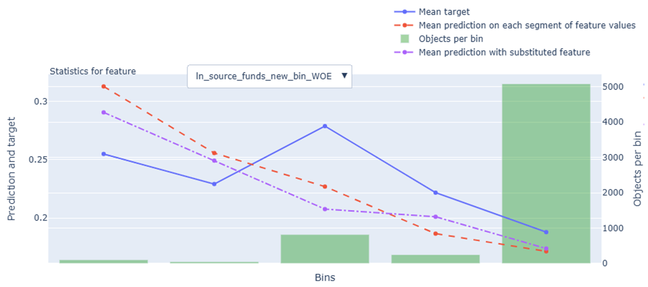
Rank# 4: ln_source_funds_new_bin ( 2 / 5 ) - Feature Statistics Analysis <Disbursed>
The red line (model prediction) generally follows the trend of the blue line (actual target), showing the model is effectively using this feature.
A visible gap between the red and purple lines indicates that the feature contributes meaningfully to prediction accuracy.
The green bars (data per bin) show that while some bins have fewer records, the last bin contains the majority, and the model handles this distribution well.
The target rate decreases across bins, which aligns with the WOE transformation and supports the feature’s use in the model.

Slide 35
Rank# 4: ln_source_funds_new_bin ( 3 / 5 ) - MoM Feature Distribution <Applied>
ln_source_funds_new_bin | Applied Count | Approval Rate | salary | income from business | less_frequent_cat | remittance | missing | new |  | Avg. Demo Score
2024-10 | 50,582 | 7.9% | 72.8% | 12.9% | 5.1% | 4.2% | 4.8% | 0.2% |  | 0.561049
2024-11 | 45,564 | 8.4% | 73.2% | 13.0% | 5.1% | 4.0% | 4.5% | 0.2% |  | 0.557048
2024-12 | 37,904 | 8.7% | 73.0% | 13.5% | 4.8% | 4.4% | 4.2% | 0.2% |  | 0.548927
2025-01 | 41,196 | 8.6% | 74.0% | 12.6% | 4.8% | 4.3% | 4.1% | 0.2% |  | 0.548719
2025-02 | 43,277 | 7.7% | 73.5% | 12.9% | 5.0% | 4.3% | 4.1% | 0.2% |  | 0.548875
2025-03 | 36,089 | 8.0% | 73.4% | 12.9% | 5.1% | 4.2% | 4.0% | 0.3% |  | 0.546775
2025-04 | 36,182 | 7.2% | 74.7% | 13.8% | 4.5% | 4.4% | 2.3% | 0.3% |  | 0.545994
2025-05 | 34,393 | 8.0% | 76.7% | 14.7% | 3.7% | 4.7% | 0.0% | 0.2% |  | 0.542096
2025-06 | 42,285 | 7.7% | 74.7% | 15.0% | 5.5% | 4.5% | 0.0% | 0.3% |  | 0.546284
2025-07 | 42,637 | 7.2% | 72.5% | 15.3% | 7.3% | 4.4% | 0.1% | 0.4% |  | 0.549238
2025-08 | 39,958 | 7.6% | 72.4% | 15.0% | 7.7% | 4.5% | 0.0% | 0.4% |  | 0.550130
Salary remains the main source of funds across all months, while business income steadily increases from 12.8% to 15.0%, reflecting a genuine shift in customer profiles.
Missing data drops to 0% by June 2025, indicating improved data quality and better feature reliability.
The distribution is stable and interpretable, with no abrupt changes, making the feature both trustworthy and predictive over time.

Slide 36
Rank# 4: ln_source_funds_new_bin ( 4 / 5 ) - MoM Feature Distribution <Applied> <User Type wise>
New Applicant
ln_source_funds_new_bin | Applied Count | Approval Rate | salary | income from business | less_frequent_cat | remittance | missing | new |  | Avg. Demo Score
2024-10 | 48,679 | 7.0% | 72.3% | 13.2% | 5.2% | 4.0% | 5.0% | 0.2% |  | 0.564780
2024-11 | 43,517 | 7.5% | 72.8% | 13.3% | 5.3% | 3.8% | 4.7% | 0.2% |  | 0.561230
2024-12 | 34,606 | 7.0% | 71.8% | 14.0% | 5.1% | 4.3% | 4.5% | 0.3% |  | 0.556868
2025-01 | 37,704 | 6.9% | 73.2% | 12.9% | 5.2% | 4.1% | 4.4% | 0.2% |  | 0.556664
2025-02 | 39,881 | 6.4% | 72.9% | 13.0% | 5.4% | 4.1% | 4.4% | 0.2% |  | 0.556129
2025-03 | 32,281 | 6.1% | 72.5% | 13.2% | 5.7% | 4.0% | 4.4% | 0.3% |  | 0.556870
2025-04 | 32,359 | 5.3% | 73.9% | 14.0% | 5.0% | 4.3% | 2.5% | 0.3% |  | 0.555703
2025-05 | 30,492 | 5.8% | 75.9% | 15.1% | 4.1% | 4.7% | 0.0% | 0.2% |  | 0.552444
2025-06 | 37,846 | 5.9% | 74.0% | 15.1% | 6.0% | 4.5% | 0.0% | 0.3% |  | 0.555536
2025-07 | 38,034 | 5.3% | 71.8% | 15.4% | 8.0% | 4.4% | 0.1% | 0.4% |  | 0.559003
2025-08 | 36,000 | 5.0% | 71.8% | 15.2% | 8.3% | 4.4% | 0.0% | 0.4% |  | 0.559164
Salary remains the top source, ranging from 71.7% to 75.9%, peaking in May before dipping slightly in June.
Income from business grows steadily from 13.1% to 15.1%, showing a gradual shift to entrepreneurial sources.
Less frequent sources and remittances stay stable, while missing data drops from 5.1% to 0.0%.
Overall, income sources diversify slowly, with improved data quality and no sharp changes.
Repeat Applicant
ln_source_funds_new_bin | Applied Count | Approval Rate | salary | income from business | remittance | missing | less_frequent_cat | new |  | Avg. Demo Score
2024-10 | 1,903 | 31.1% | 84.2% | 5.8% | 8.8% | 0.5% | 0.6% | 0.1% |  | 0.465621
2024-11 | 2,047 | 27.0% | 82.2% | 7.7% | 8.4% | 0.6% | 1.2% | 0.0% |  | 0.468136
2024-12 | 3,298 | 26.4% | 84.7% | 7.6% | 5.7% | 0.7% | 1.2% | 0.0% |  | 0.465606
2025-01 | 3,492 | 26.2% | 83.2% | 9.2% | 6.6% | 0.4% | 0.5% | 0.1% |  | 0.462927
2025-02 | 3,396 | 23.2% | 80.3% | 10.9% | 6.8% | 0.9% | 1.1% | 0.1% |  | 0.463683
2025-03 | 3,808 | 24.6% | 80.8% | 11.0% | 6.3% | 0.8% | 1.1% | 0.1% |  | 0.461201
2025-04 | 3,823 | 23.1% | 81.0% | 12.4% | 5.0% | 0.8% | 0.7% | 0.1% |  | 0.463816
2025-05 | 3,901 | 25.7% | 82.6% | 11.9% | 4.7% | 0.7% | 0.0% | 0.1% |  | 0.461210
2025-06 | 4,439 | 23.6% | 80.6% | 13.7% | 4.1% | 1.4% | 0.1% | 0.1% |  | 0.467403
2025-07 | 4,603 | 23.1% | 78.8% | 14.3% | 4.5% | 1.9% | 0.2% | 0.4% |  | 0.468555
2025-08 | 3,958 | 31.5% | 77.9% | 13.7% | 6.0% | 2.0% | 0.0% | 0.3% |  | 0.467967
Salary stays dominant and stable, ranging from 80.3% to 84.9%, with a slight decline by June.
Business income rises steadily from 5.6% to 13.7%, showing growing self-employment activity.
Other sources remain low and stable; remittance and less frequent categories show little change.
Missing data edges up slightly to 1.5%, but overall patterns remain consistent.

Slide 37
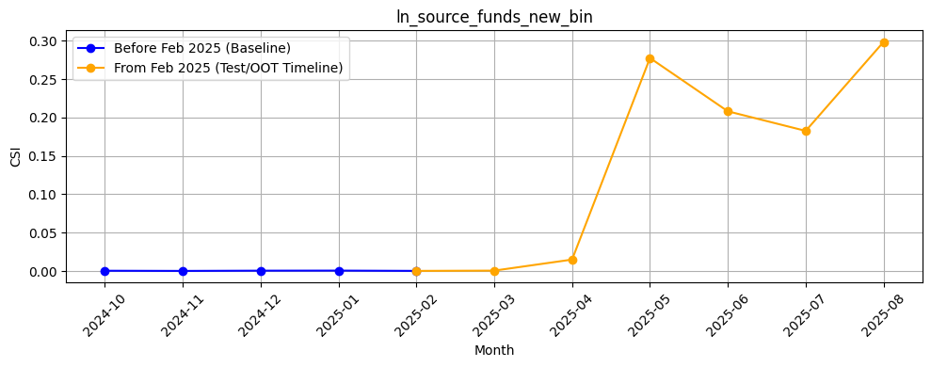
Rank# 4: ln_source_funds_new_bin ( 5 / 5 ) - Feature CSI Analysis <Applied>
Here the baseline data considered is Oct’2024 to Jan’2025.
During the baseline period, CSI values were consistently around 0 — indicating perfect stability and no drift.
However, in the Test/OOT period (Feb to Jun 2025), a significant spike was observed: CSI rose sharply starting April and peaked above 0.27 in May 2025, before slightly dropping to ~0.21 in June.

Slide 38
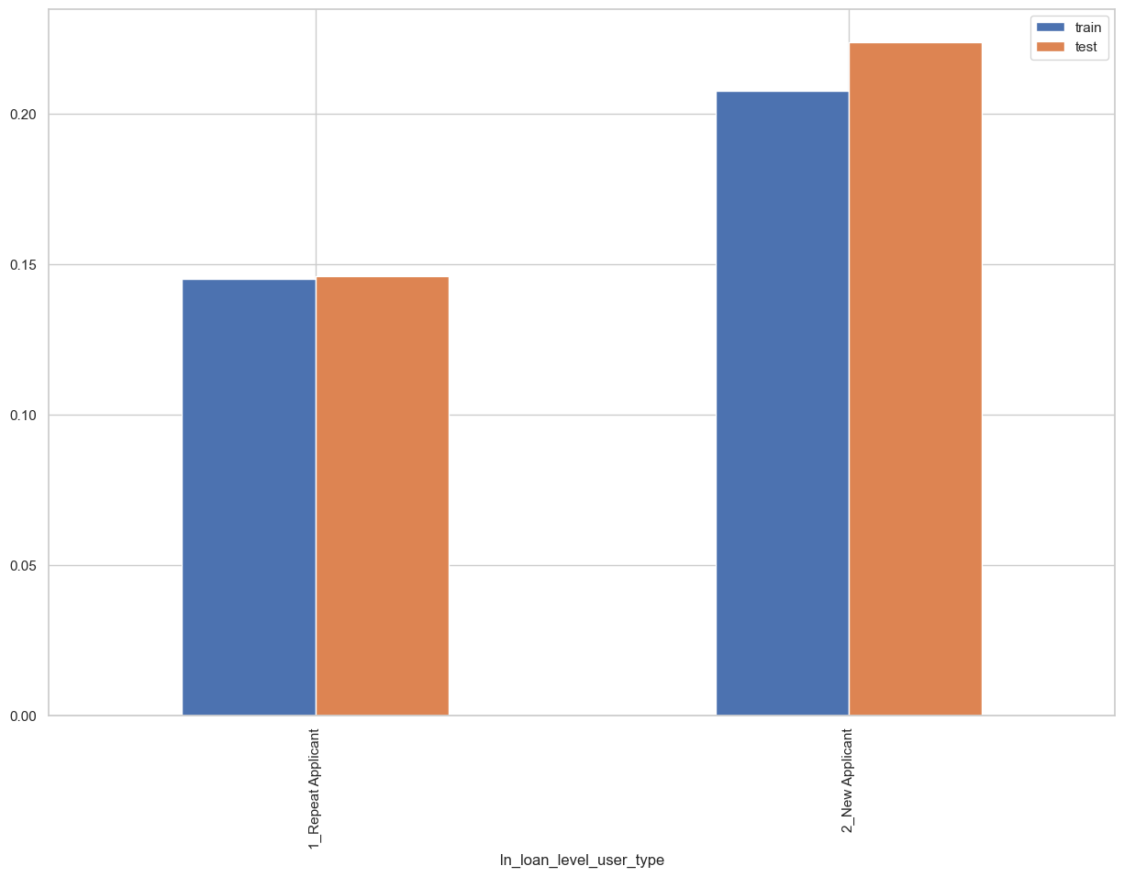
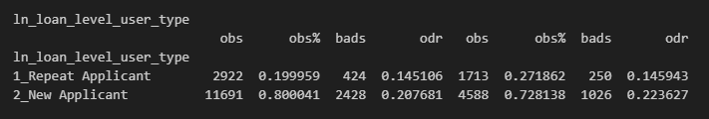
Rank# 5: ln_loan_level_user_type ( 1 / 4 ) - Feature Performance in Train vs Test <Disbursed>
It represents user type whether a new or repeat (repeat if the customer had any disbursed loans in the past with Tonik else new)

Slide 39
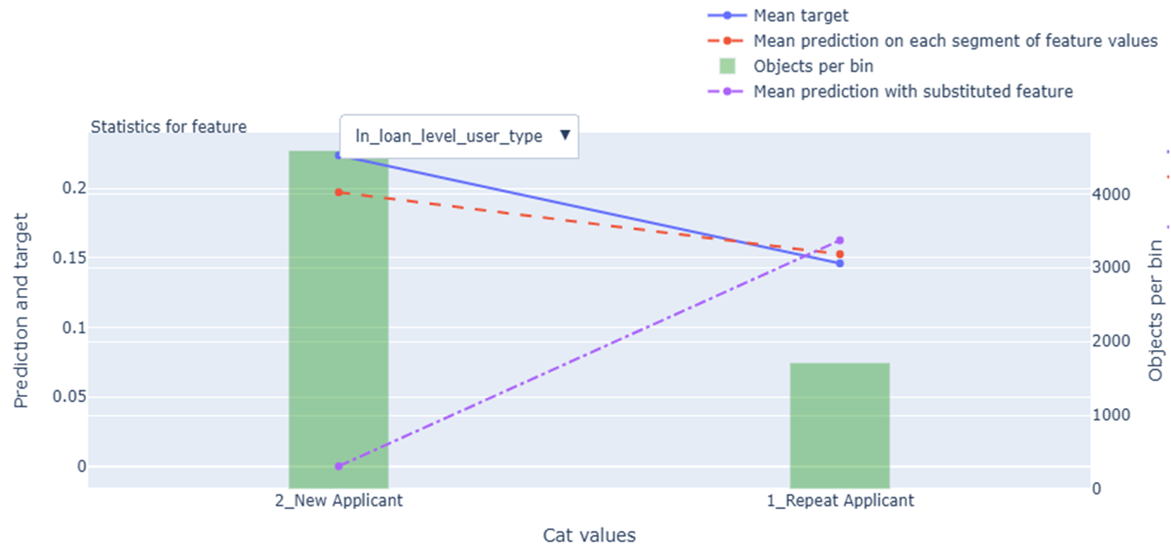
Rank# 5: ln_loan_level_user_type ( 2 / 4 ) - Feature Statistics Analysis <Disbursed>
The red line (model prediction) follows the trend of the blue line (actual target), showing the model is using this feature effectively.
There is a visible gap between the red and purple lines, which suggests the feature improves the model’s predictive performance.
The green bars (data per bin) show that new applicants form the majority of records, while repeat applicants are less represented but still significant.
The target rate is higher for new applicants compared to repeat applicants, supporting the feature’s value in distinguishing user types.
39

Slide 40
Rank# 5: ln_loan_level_user_type ( 3 / 4 ) - MoM Feature Distribution <Applied>
ln_loan_level_user_type | Applied Count | Approval Rate | 2_New Applicant | 1_Repeat Applicant |  | Avg. Demo Score
2024-10 | 50,582 | 7.9% | 96.2% | 3.8% |  | 0.561049
2024-11 | 45,564 | 8.4% | 95.5% | 4.5% |  | 0.557048
2024-12 | 37,904 | 8.7% | 91.3% | 8.7% |  | 0.548927
2025-01 | 41,196 | 8.6% | 91.5% | 8.5% |  | 0.548719
2025-02 | 43,277 | 7.7% | 92.2% | 7.8% |  | 0.548875
2025-03 | 36,089 | 8.0% | 89.4% | 10.6% |  | 0.546775
2025-04 | 36,182 | 7.2% | 89.4% | 10.6% |  | 0.545994
2025-05 | 34,393 | 8.0% | 88.7% | 11.3% |  | 0.542096
2025-06 | 42,285 | 7.7% | 89.5% | 10.5% |  | 0.546284
2025-07 | 42,637 | 7.2% | 89.2% | 10.8% |  | 0.549238
2025-08 | 39,958 | 7.6% | 90.1% | 9.9% |  | 0.550130
New Applicants consistently represent the dominant group, maintaining a high share (above 88%) across all months, indicating strong feature stability.
The gradual rise in Repeat Applicants is smooth and explainable, reflecting natural user lifecycle progression—not volatility—ensuring reliability.
The binary split between New and Repeat Applicants remains simple and transparent, supporting interpretability and consistent model behavior over time.
40

Slide 41
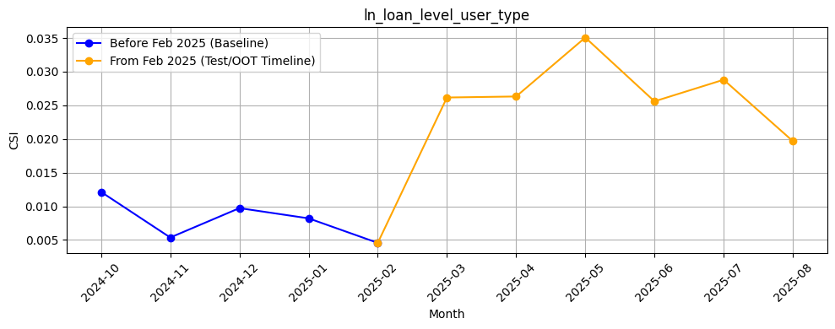
Rank# 5: ln_loan_level_user_type ( 4 / 4 ) - Feature CSI Analysis <Applied>
Here the baseline data considered is Oct’2024 to Jan’2025.
CSI values during the training period were consistently low — around 0.002 — indicating high feature stability and no early signs of drift.
In the Test/OOT period (Feb to Jun 2025), CSI gradually increased, reaching a peak of just over 0.01 in May. Despite this upward trend, all values remained well below the standard drift threshold of 0.1, confirming that the feature continues to be reliable and stable over time.
41

Slide 42
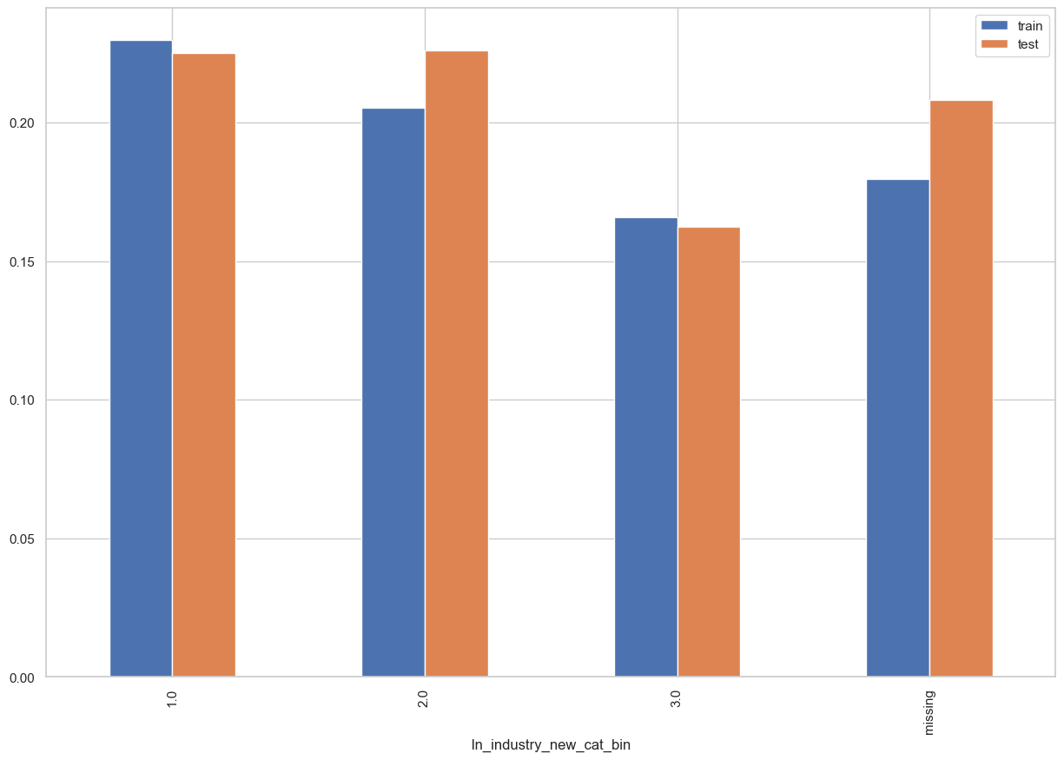
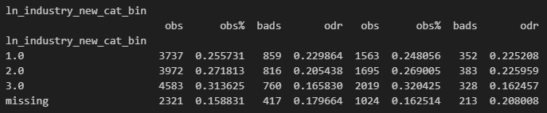
Rank# 6: ln_industry_new_cat_bin ( 1 / 4 ) - Feature Performance in Train vs Test <Disbursed>
Type of industry in which loan applicant is employed. Any industry that does not fall under the predefined categories is grouped into a new category called “New”
Bad_PCT | ln_industry_new_cat | Bin
Bad_PCT <= 18 | 'accounting/bookkeeping/auditing', 'architecture/engineering', 'banking', 'computer/it related services', 'education/private schools', 'fin tech/financial services', 'fx dealer/money changer', 'gold/jewelry/precious metals/art/antique dealership', 'govt. institution', 'hospital and medical services', 'ngos/nonprofit organization/foundation', 'religious organization', 'repair, sanitation and housekeeping', 'utilities (electricity, gas and water)' | 3
18 < Bad_PCT <= 22 | 'airline/aviation', 'construction', "convenience store/internet cafe's", 'freight and cargo', 'manpower/manning agencies', 'manufacturing', 'maritime/shipping', 'others', 'pawnshop/remittance agent/virtual currency', 'real estate', 'telecommunication', 'tourism, hotel and resorts', 'wholesale and retail trade' | 2
Bad_PCT >22 | 'advertising/sales/marketing', 'agribusiness/animal farming/fishing', 'beauty and health services', 'business process outsourcing/tele marketing', 'food industry/restaurants/fastfoods', 'gambling and betting (online gaming, lottery, casino)', 'insurance activities', 'legal service/law firm', 'recreation (arts, entertainment/media, sports)', 'transportation' | 1
missing | Users with their source of funds as 'Remittance’, 'Pension’, 'Inheritance/Retirement Funds’, 'Interest on Deposits and Investments’, 'Allowance'

Slide 43
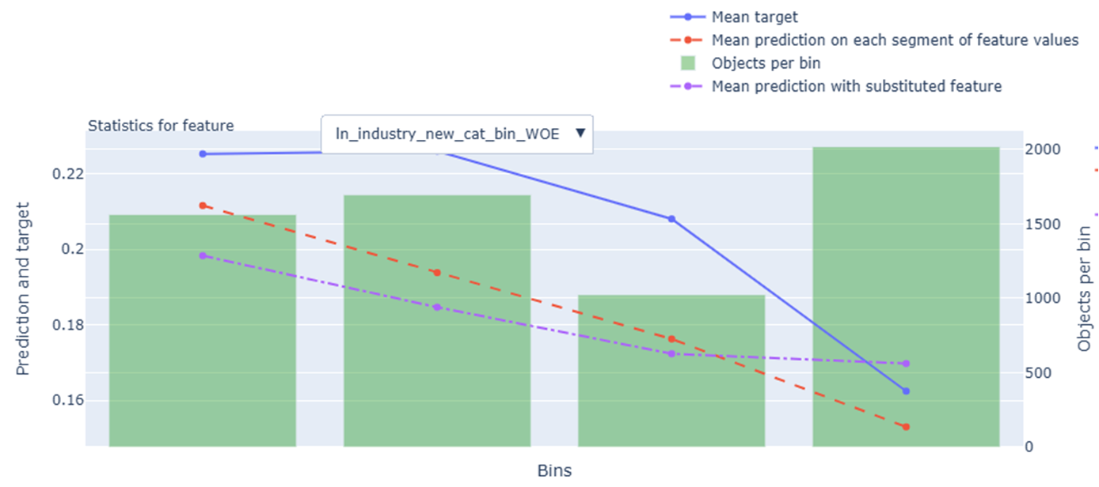
Rank# 6: ln_industry_new_cat_bin ( 2 / 4 ) - Feature Statistics Analysis <Disbursed>
The red line (model prediction) generally follows the trend of the blue line (actual target), indicating the model is learning from this feature.
A clear gap between the red and purple lines suggests the feature contributes to better predictions.
The green bars (data per bin) show a balanced distribution, with all bins having sufficient data.
The target rate decreases across bins, which aligns with the WOE transformation and supports the feature’s use in the model.
43

Slide 44
Rank# 6: ln_industry_new_cat_bin ( 3 / 4 ) - MoM Feature Distribution <Applied>
ln_industry_new_cat_bin | Applied Count | Approval Rate | 2 | 1 | 3 | missing | new |  | Avg. Demo Score
2024-10 | 50,582 | 7.9% | 35.5% | 28.1% | 20.4% | 15.9% | 0.0% |  | 0.561049
2024-11 | 45,564 | 8.4% | 35.4% | 28.9% | 20.4% | 15.3% | 0.0% |  | 0.557048
2024-12 | 37,904 | 8.7% | 34.3% | 27.5% | 21.6% | 16.6% | 0.0% |  | 0.548927
2025-01 | 41,196 | 8.6% | 33.4% | 27.2% | 22.6% | 16.9% | 0.0% |  | 0.548719
2025-02 | 43,277 | 7.7% | 33.7% | 28.3% | 21.4% | 16.5% | 0.0% |  | 0.548875
2025-03 | 36,089 | 8.0% | 33.8% | 27.8% | 21.2% | 17.2% | 0.0% |  | 0.546775
2025-04 | 36,182 | 7.2% | 33.3% | 28.7% | 22.9% | 15.1% | 0.0% |  | 0.545994
2025-05 | 34,393 | 8.0% | 32.0% | 31.2% | 25.2% | 11.4% | 0.2% |  | 0.542096
2025-06 | 42,285 | 7.7% | 31.6% | 32.0% | 24.7% | 11.1% | 0.7% |  | 0.546284
2025-07 | 42,637 | 7.2% | 30.4% | 31.3% | 24.9% | 12.9% | 0.6% |  | 0.549238
2025-08 | 39,958 | 7.6% | 30.5% | 30.6% | 25.1% | 13.3% | 0.5% |  | 0.550130
The overall category distribution shifts gradually over time, with category 2 declining slightly while categories 1 and 3 rise smoothly — showing no sudden spikes or drops, which reflects high stability.
The ‘missing’ share consistently decreases from 15.9% to 11.1%, and the controlled introduction of the “new” category (up to 0.7%) suggests improved data handling, not noise.
Month-on-month trends are predictable and consistent, confirming that this feature behaves reliably and is stable enough for modeling use.
44

Slide 45
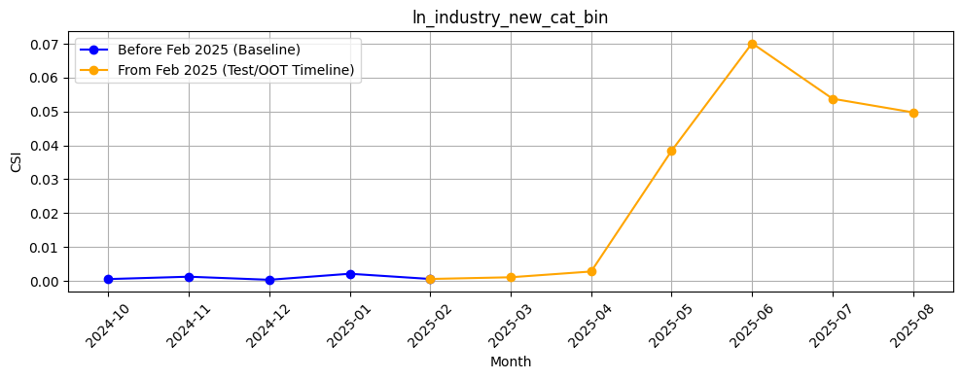
Rank# 6: ln_industry_new_cat_bin ( 4 / 4 ) - Feature CSI Analysis <Applied>
Here the baseline data considered is Oct’2024 to Jan’2025.
During the baseline period, CSI values were virtually zero — demonstrating excellent stability and no evidence of drift during training.
In the Test/OOT period (Feb to Jun 2025), CSI values began rising in April and peaked at approximately 0.07 in June. While this increase shows a notable upward trend, the values still remain below the 0.1 threshold, which means the feature has not breached the drift criteria.
45

Slide 46
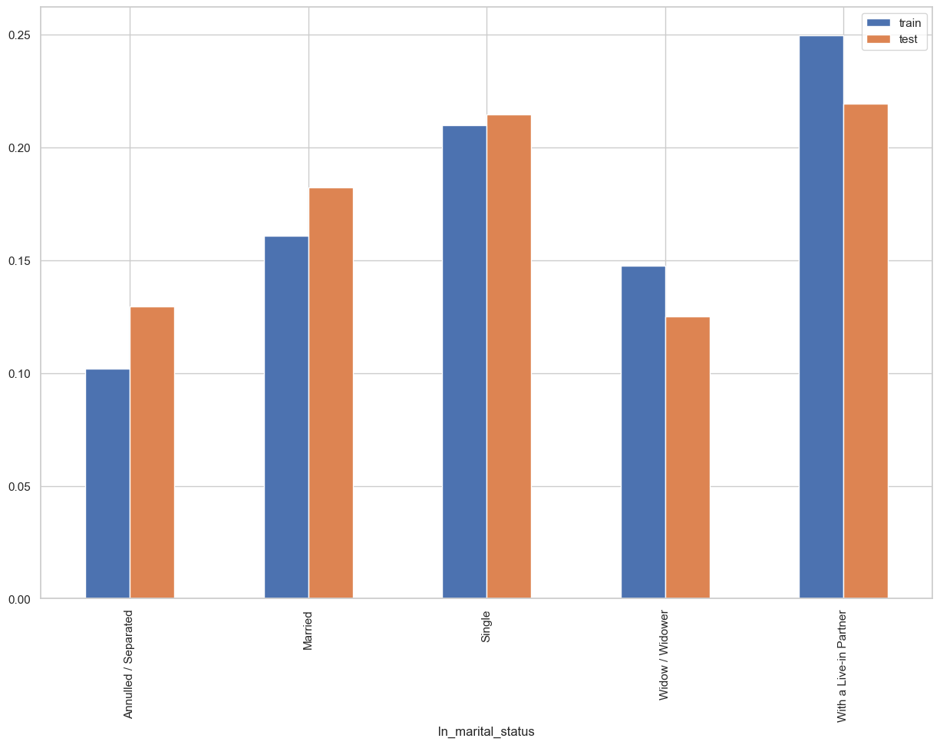
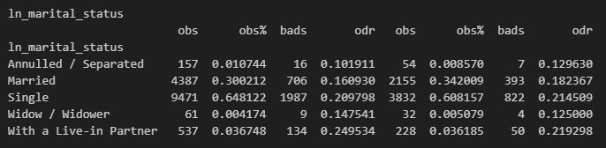
Rank# 7: ln_marital_status ( 1 / 4 ) - Feature Performance in Train vs Test <Disbursed>
It indicates the marital status of the loan applicant.

Slide 47
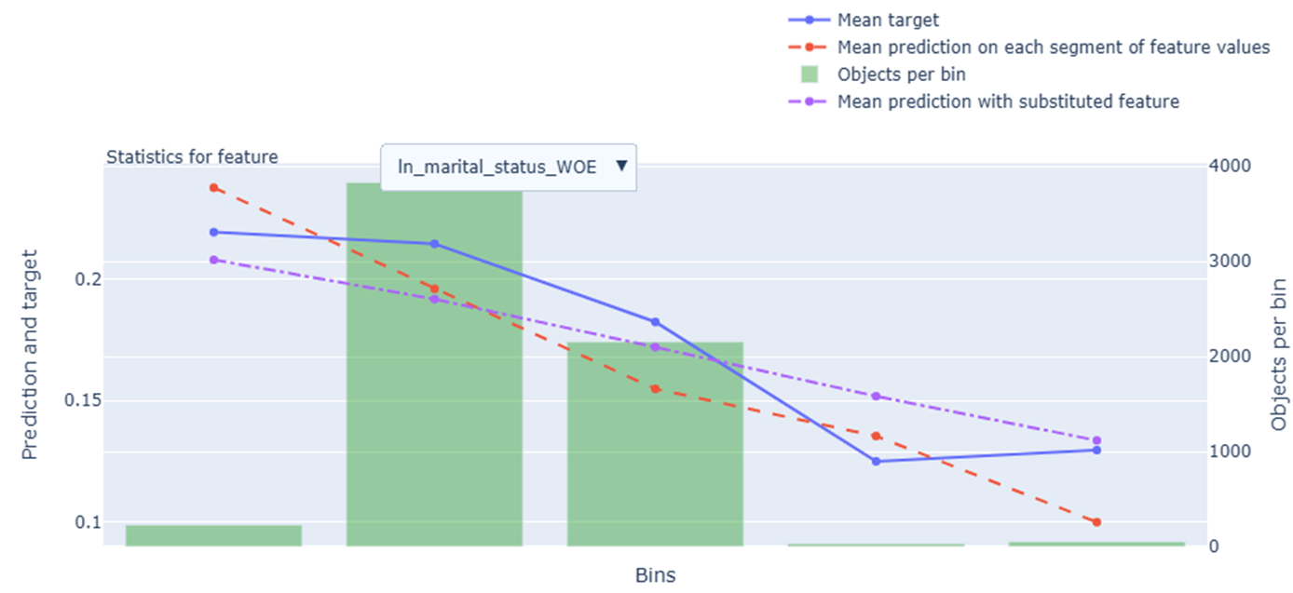
Rank# 7: ln_marital_status ( 2 / 4 ) - Feature Statistics Analysis <Disbursed>
The red line (model prediction) closely follows the trend of the blue line (actual target), indicating the model is effectively using this feature.
A noticeable gap between the red and purple lines suggests that this feature contributes positively to prediction performance.
The green bars (data per bin) show a strong concentration in the middle bins, with sparse data at the extremes.
The target rate decreases across bins, aligning with the WOE transformation and supporting the feature’s inclusion in the model.
47

Slide 48
Rank# 7: ln_marital_status ( 3 / 4 ) - MoM Feature Distribution <Applied>
ln_marital_status | Applied Count | Approval Rate | Single | Married | With a Live-in Partner | Annulled / Separated | Widow / Widower |  | Avg. Demo Score
2024-10 | 50,582 | 7.9% | 66.6% | 25.5% | 6.5% | 0.7% | 0.7% |  | 0.561049
2024-11 | 45,564 | 8.4% | 67.5% | 25.1% | 6.1% | 0.8% | 0.7% |  | 0.557048
2024-12 | 37,904 | 8.7% | 66.2% | 26.3% | 6.0% | 0.8% | 0.7% |  | 0.548927
2025-01 | 41,196 | 8.6% | 68.1% | 25.0% | 5.6% | 0.7% | 0.7% |  | 0.548719
2025-02 | 43,277 | 7.7% | 68.7% | 24.4% | 5.6% | 0.7% | 0.6% |  | 0.548875
2025-03 | 36,089 | 8.0% | 69.4% | 23.9% | 5.4% | 0.6% | 0.6% |  | 0.546775
2025-04 | 36,182 | 7.2% | 68.7% | 24.0% | 6.1% | 0.6% | 0.7% |  | 0.545994
2025-05 | 34,393 | 8.0% | 67.6% | 24.1% | 6.9% | 0.7% | 0.6% |  | 0.542096
2025-06 | 42,285 | 7.7% | 67.5% | 24.3% | 6.9% | 0.7% | 0.7% |  | 0.546284
2025-07 | 42,637 | 7.2% | 67.5% | 24.5% | 6.7% | 0.6% | 0.8% |  | 0.549238
2025-08 | 39,958 | 7.6% | 68.8% | 23.7% | 6.2% | 0.6% | 0.7% |  | 0.550130
The "Single" category remains dominant, ranging consistently between 66% and 69%, showing strong and stable representation over time.
Other categories like "Married" and "Live-in Partner" fluctuate only slightly (within 1–2%), suggesting minimal volatility in user profiles.
Low-frequency categories such as "Annulled/Separated" and "Widow/Widower" remain consistently under 1%, confirming distributional stability month over month.
48

Slide 49
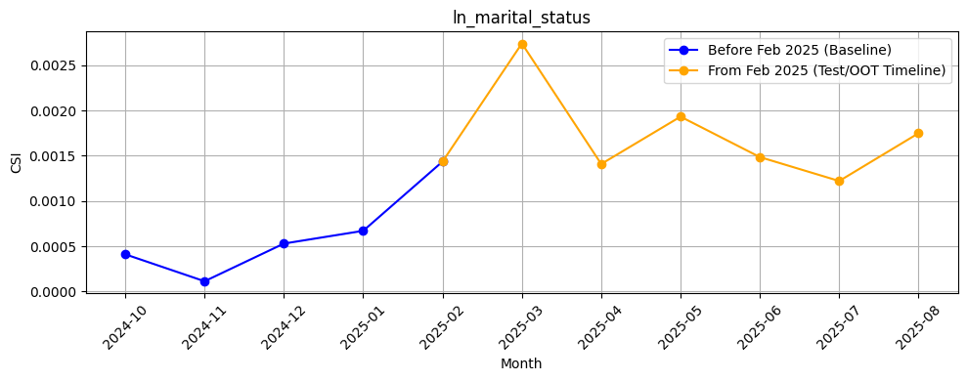
Rank# 7: ln_marital_status ( 4 / 4 ) - Feature CSI Analysis <Applied>
Here the baseline data considered is Oct’2024 to Jan’2025.
Throughout the baseline period, CSI values were extremely low — well below 0.001 — demonstrating very strong feature stability.
In the Test/OOT period (Feb to Jun 2025), CSI values remained similarly low, with a slight peak in March 2025 (~0.0028). Despite this uptick, all values were an order of magnitude below the 0.1 drift threshold, clearly indicating that no meaningful data drift is present.
49

Slide 50
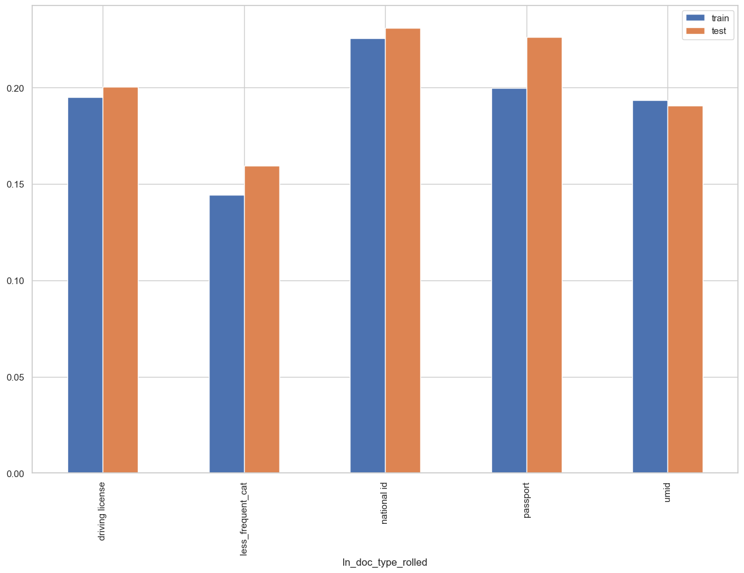
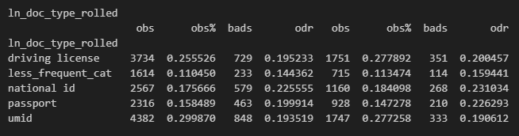
Rank# 8: ln_doc_type_rolled ( 1 / 4 ) - Feature Performance in Train vs Test <Disbursed>
It represent the type of identification document provided by the loan applicant.
Less_Frequency_Cat
professional id card, social security card, postal id card, health card, voter card, tax card

Slide 51
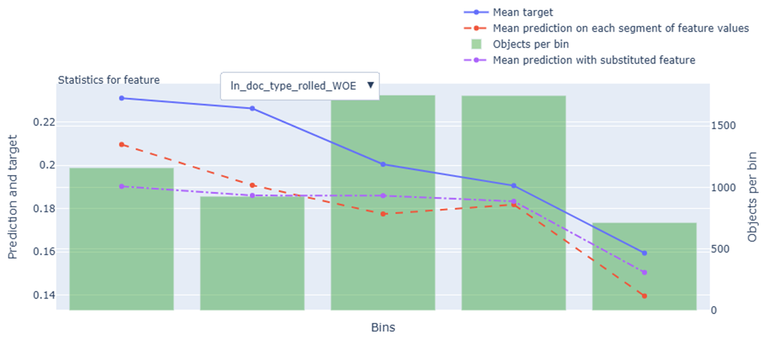
Rank# 8: ln_doc_type_rolled ( 2 / 4 ) - Feature Statistics Analysis <Disbursed>
The red line (model prediction) generally follows the trend of the blue line (actual target), showing the model is effectively using this feature.
A visible gap between the red and purple lines suggests that this feature contributes to improved prediction accuracy.
The green bars (data per bin) show a relatively even distribution across bins, with no major sparsity issues.
The target rate decreases across bins, which aligns with the WOE transformation and supports the feature’s use in the model.
51

Slide 52
Rank# 8: ln_doc_type_rolled ( 3 / 4 ) - MoM Feature Distribution <Applied>
ln_doc_type_rolled | Applied Count | Approval Rate | national id | driving license | umid | passport | less_frequent_cat |  | Avg. Demo Score
2024-10 | 50,582 | 7.9% | 35.1% | 21.9% | 22.3% | 12.6% | 8.0% |  | 0.561049
2024-11 | 45,564 | 8.4% | 34.0% | 22.3% | 22.4% | 13.2% | 8.1% |  | 0.557048
2024-12 | 37,904 | 8.7% | 32.3% | 22.3% | 22.5% | 14.0% | 8.8% |  | 0.548927
2025-01 | 41,196 | 8.6% | 34.0% | 22.8% | 21.4% | 13.3% | 8.6% |  | 0.548719
2025-02 | 43,277 | 7.7% | 36.1% | 22.2% | 20.5% | 13.0% | 8.1% |  | 0.548875
2025-03 | 36,089 | 8.0% | 37.0% | 21.7% | 19.6% | 13.4% | 8.3% |  | 0.546775
2025-04 | 36,182 | 7.2% | 37.1% | 21.8% | 19.5% | 13.3% | 8.3% |  | 0.545994
2025-05 | 34,393 | 8.0% | 36.2% | 21.8% | 19.7% | 13.9% | 8.4% |  | 0.542096
2025-06 | 42,285 | 7.7% | 37.3% | 22.8% | 18.9% | 13.4% | 7.7% |  | 0.546284
2025-07 | 42,637 | 7.2% | 38.8% | 22.6% | 17.6% | 13.3% | 7.6% |  | 0.549238
2025-08 | 39,958 | 7.6% | 37.1% | 23.4% | 17.2% | 14.4% | 7.9% |  | 0.550130
“National ID” consistently leads, increasing steadily from 35.1% to 37.3%, showing a stable and dominant document type across months.
Other categories like “Driving License”, “UMID”, and “Passport” stay within narrow, predictable ranges, indicating distributional consistency.
The “less frequent” category remains stable around 8%, confirming that even low-volume document types show no abrupt changes or volatility.

Slide 53
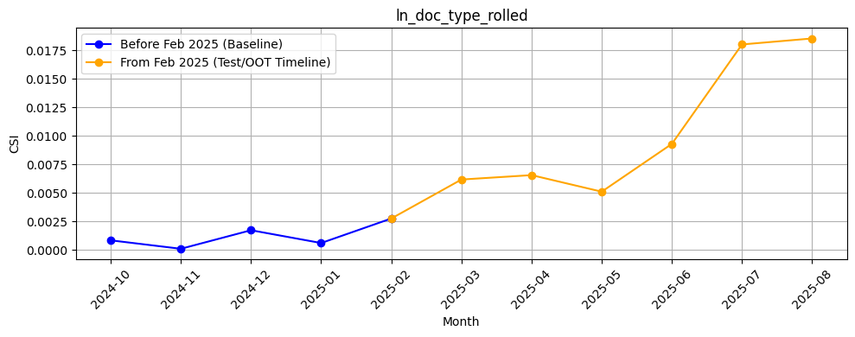
Rank# 8: ln_doc_type_rolled ( 4 / 4 ) - Feature CSI Analysis <Applied>
Here the baseline data considered is Oct’2024 to Jan’2025.
Throughout the baseline period, CSI values were low, remaining under 0.002 — indicating good stability during training.
In the Test/OOT period (Feb to Jun 2025), CSI values showed a steady upward trend, rising from around 0.0028 in Feb to approximately 0.0087 in June. Although there's a consistent increase, the values remain well below the 0.1 threshold, signifying that no significant data drift is present.

Slide 54
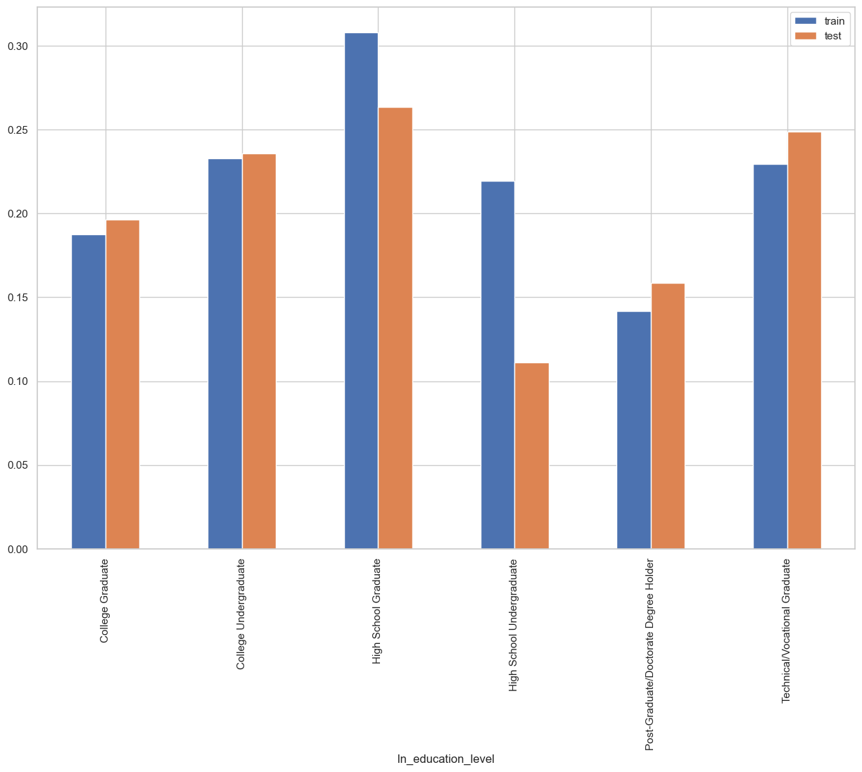
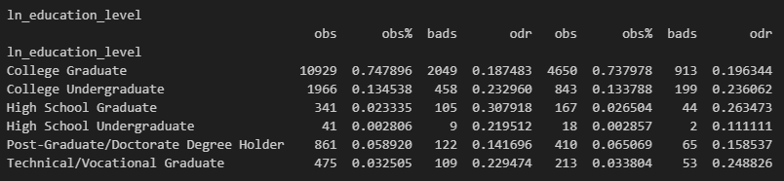
Rank# 9: ln_education_level ( 1 / 4 ) - Feature Performance in Train vs Test <Disbursed>
Highest Education Level of loan applicant.

Slide 55
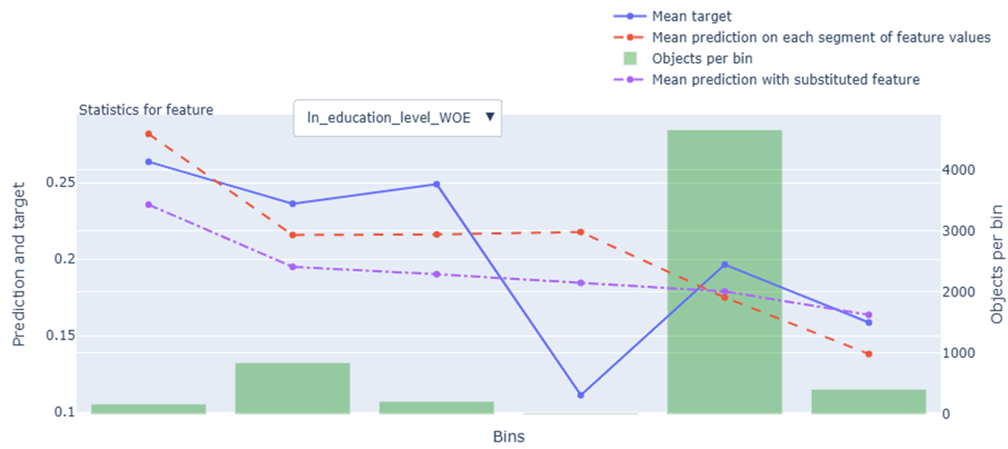
Rank# 9: ln_education_level ( 2 / 4 ) - Feature Statistics Analysis <Disbursed>
The red line (model prediction) generally follows the trend of the blue line (actual target), indicating the model is using this feature effectively.
A noticeable gap between the red and purple lines suggests that this feature helps improve prediction accuracy.
The green bars (data per bin) show uneven distribution, with most records concentrated in one central bin.
The target rate shows variation across bins, which aligns with the WOE encoding and supports the feature’s value in the model.
55

Slide 56
Rank# 9: ln_education_level ( 3 / 4 ) - MoM Feature Distribution <Applied>
ln_education_level | Applied Count | Approval Rate | College Graduate | College Undergraduate | High School Graduate | Technical/Vocational Graduate | Post-Graduate/Doctorate Degree Holder | High School Undergraduate |  | Avg. Demo Score
2024-10 | 50,582 | 7.9% | 48.9% | 23.7% | 14.8% | 8.5% | 2.3% | 1.8% |  | 0.561049
2024-11 | 45,564 | 8.4% | 50.5% | 23.8% | 13.7% | 8.0% | 2.3% | 1.7% |  | 0.557048
2024-12 | 37,904 | 8.7% | 51.9% | 23.1% | 13.0% | 7.7% | 2.7% | 1.7% |  | 0.548927
2025-01 | 41,196 | 8.6% | 52.0% | 22.9% | 13.1% | 7.5% | 3.0% | 1.6% |  | 0.548719
2025-02 | 43,277 | 7.7% | 51.2% | 23.2% | 13.8% | 7.6% | 2.6% | 1.7% |  | 0.548875
2025-03 | 36,089 | 8.0% | 51.3% | 23.1% | 13.8% | 7.6% | 2.6% | 1.6% |  | 0.546775
2025-04 | 36,182 | 7.2% | 51.4% | 22.3% | 14.3% | 7.8% | 2.5% | 1.6% |  | 0.545994
2025-05 | 34,393 | 8.0% | 51.5% | 22.7% | 13.9% | 7.8% | 2.5% | 1.7% |  | 0.542096
2025-06 | 42,285 | 7.7% | 50.1% | 23.2% | 14.6% | 7.9% | 2.5% | 1.7% |  | 0.546284
2025-07 | 42,637 | 7.2% | 49.1% | 23.8% | 14.9% | 7.6% | 2.5% | 2.2% |  | 0.549238
2025-08 | 39,958 | 7.6% | 49.5% | 23.0% | 15.4% | 7.5% | 2.5% | 2.1% |  | 0.550130
“College Graduate” is the leading category throughout, consistently around 50–52%, showing strong dominance and stable representation.
Other education groups like “College Undergrad,” “High School Graduate,” and “Technical/Vocational” stay within narrow ranges, reflecting steady and balanced trends.
Low-frequency categories (e.g., Post-Graduate, High School Undergrad) remain stable and under 3%, confirming consistent month-on-month distribution.

Slide 57
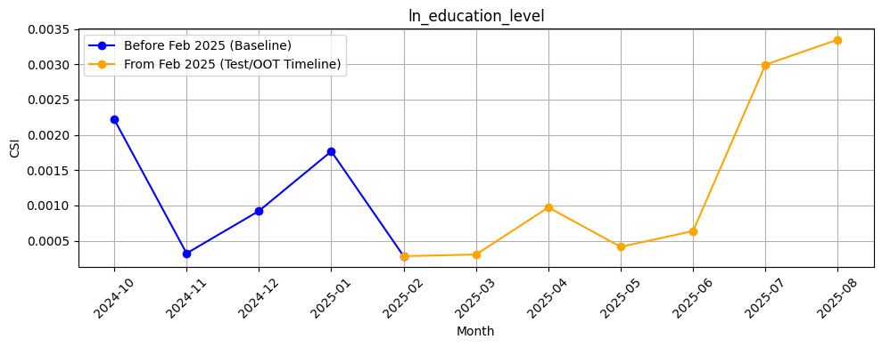
Rank# 9: ln_education_level ( 4 / 4 ) - Feature CSI Analysis <Applied>
Here the baseline data considered is Oct’2024 to Jan’2025.
During the training window, CSI values ranged between ~0.0003 and ~0.0022, indicating very low variability and strong feature stability across the baseline months.
In the Test/OOT period (Feb to Jun 2025), CSI values continued to stay extremely low, peaking just below 0.001 in April. All values remained well below the 0.1 threshold, showing no signs of data drift.

Slide 58
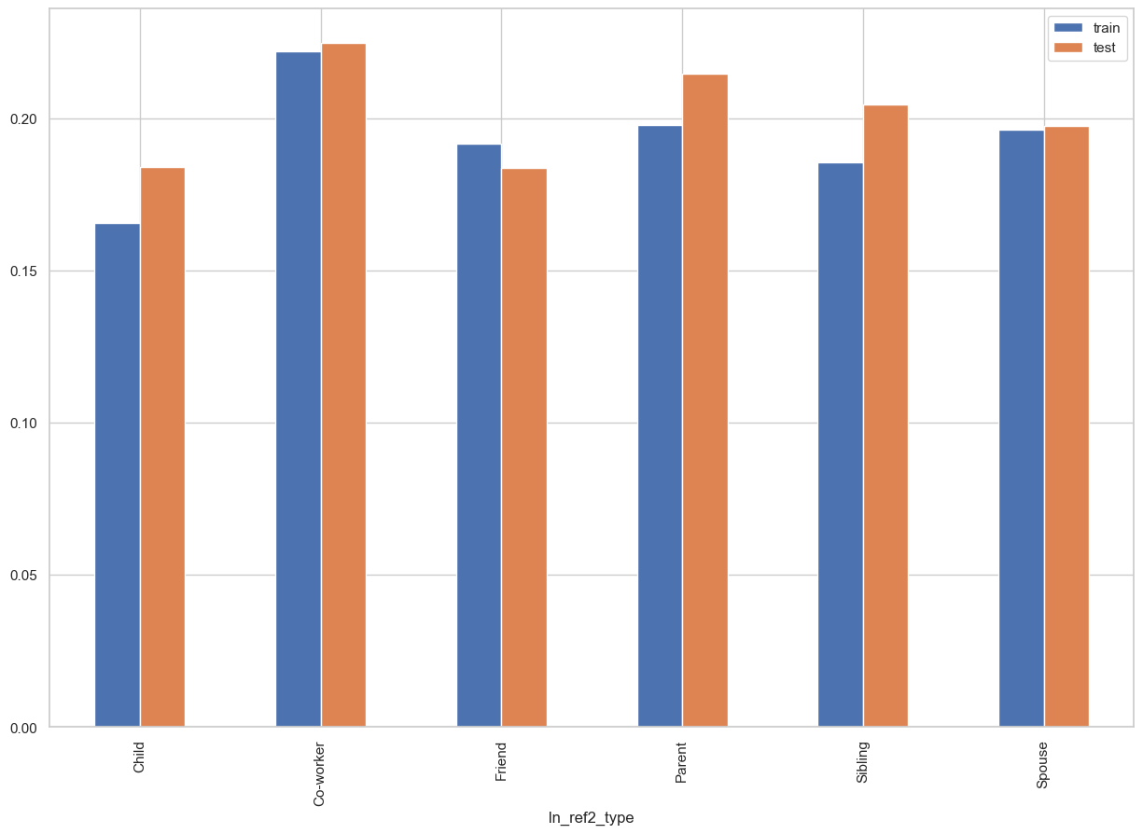
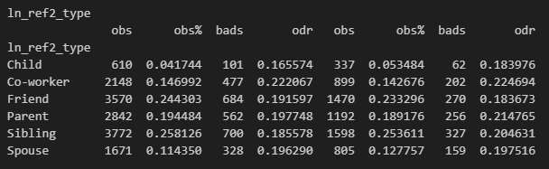
Rank# 10: ln_ref2_type ( 1 / 4 ) - Feature Performance in Train vs Test <Disbursed>
Relationship of the second reference person to the individual (e.g., sibling, friend, spouse).

Slide 59

Rank# 10: ln_ref2_type ( 2 / 4 ) - Feature Statistics Analysis <Disbursed>
The red line (model prediction) generally follows the trend of the blue line (actual target), indicating the model is using this feature effectively.
A noticeable gap between the red and purple lines suggests that the feature contributes positively to prediction accuracy.
The green bars (data per bin) show a well-distributed sample across bins, with good representation in the middle ranges.
The target rate shows variation across bins, which aligns with the WOE encoding and supports the feature’s value in the model.
59

Slide 60
Rank# 10: ln_ref2_type ( 3 / 4 ) - MoM Feature Distribution <Applied>
ln_ref2_type | Applied Count | Approval Rate | Sibling | Friend | Parent | Co-worker | Spouse | Child |  | Avg. Demo Score
2024-10 | 50,582 | 7.9% | 23.0% | 25.4% | 19.7% | 15.1% | 12.1% | 4.6% |  | 0.561049
2024-11 | 45,564 | 8.4% | 23.4% | 25.9% | 19.6% | 15.1% | 11.6% | 4.6% |  | 0.557048
2024-12 | 37,904 | 8.7% | 24.4% | 23.8% | 20.0% | 14.5% | 12.2% | 5.1% |  | 0.548927
2025-01 | 41,196 | 8.6% | 24.4% | 22.8% | 21.5% | 14.3% | 12.1% | 4.9% |  | 0.548719
2025-02 | 43,277 | 7.7% | 24.5% | 22.7% | 21.3% | 14.5% | 12.3% | 4.7% |  | 0.548875
2025-03 | 36,089 | 8.0% | 24.4% | 23.2% | 21.2% | 14.3% | 12.3% | 4.6% |  | 0.546775
2025-04 | 36,182 | 7.2% | 24.6% | 23.0% | 21.5% | 13.8% | 12.3% | 4.8% |  | 0.545994
2025-05 | 34,393 | 8.0% | 25.0% | 23.5% | 21.7% | 13.3% | 11.7% | 4.9% |  | 0.542096
2025-06 | 42,285 | 7.7% | 25.1% | 23.2% | 21.4% | 13.1% | 12.0% | 5.2% |  | 0.546284
2025-07 | 42,637 | 7.2% | 25.2% | 23.5% | 21.4% | 12.6% | 12.1% | 5.2% |  | 0.549238
2025-08 | 39,958 | 7.6% | 25.7% | 23.7% | 21.7% | 12.5% | 11.3% | 5.2% |  | 0.550130
The "Sibling" reference type steadily increases from 23.0% to 25.1%, indicating a consistent preference trend without abrupt changes.
Other key categories like "Friend“, "Parent", and "Spouse" remain remarkably stable, fluctuating within narrow bands.
The overall distribution is smooth and well-balanced, showing strong feature stability across months with no volatility.
60

Slide 61

Rank# 10: ln_ref2_type ( 4 / 4 ) - Feature CSI Analysis <Applied>
Here the baseline data considered is Oct’2024 to Jan’2025.
During this training time, CSI values remained consistently low, fluctuating between approximately 0.0007 and 0.0025. This indicates strong stability and no notable data drift during the baseline.
In the Test/OOT period (February to June 2025), CSI values continued at a low level in February and March but began to increase gradually thereafter. By June 2025, the CSI reached a peak of just over 0.0045. Despite this upward trend, the values remained well below the 0.1 threshold, confirming that the ln_ref2_type feature remains stable over time and does not exhibit signs of significant drift.

Slide 62


Rank# 11: ln_email_primary_domain ( 1 / 4 ) - Feature Performance in Train vs Test <Disbursed>
Domain from the primary email address of the user.

Slide 63

Rank# 11: ln_email_primary_domain ( 2 / 4 ) - Feature Statistics Analysis <Disbursed>
The red line (model prediction) broadly follows the trend of the blue line (actual target), showing the model is using this feature effectively.
A noticeable gap between the red and purple lines suggests that the feature is helping the model make more accurate predictions.
The green bars (data per bin) show an imbalanced distribution, with most records concentrated in the first bin.
The target rate shows variation across bins, which aligns with the WOE transformation and supports the feature’s value in the model.
63

Slide 64
Rank# 11: ln_email_primary_domain ( 3 / 4 ) - MoM Feature Distribution <Applied>
ln_email_primary_domain | Applied Count | Approval Rate | gmail.com | yahoo.com | other |  | Avg. Demo Score
2024-10 | 50,582 | 7.9% | 92.2% | 6.3% | 1.4% |  | 0.561049
2024-11 | 45,564 | 8.4% | 91.7% | 6.6% | 1.7% |  | 0.557048
2024-12 | 37,904 | 8.7% | 91.1% | 7.1% | 1.8% |  | 0.548927
2025-01 | 41,196 | 8.6% | 91.4% | 6.8% | 1.9% |  | 0.548719
2025-02 | 43,277 | 7.7% | 91.4% | 6.6% | 2.0% |  | 0.548875
2025-03 | 36,089 | 8.0% | 92.0% | 6.2% | 1.8% |  | 0.546775
2025-04 | 36,182 | 7.2% | 92.3% | 5.9% | 1.8% |  | 0.545994
2025-05 | 34,393 | 8.0% | 92.3% | 5.9% | 1.8% |  | 0.542096
2025-06 | 42,285 | 7.7% | 92.6% | 5.8% | 1.7% |  | 0.546284
2025-07 | 42,637 | 7.2% | 92.6% | 5.6% | 1.8% |  | 0.549238
2025-08 | 39,958 | 7.6% | 93.1% | 5.2% | 1.7% |  | 0.550130
gmail.com remains the dominant domain, consistently above 91%, with a slight upward trend to 92.6%, showing a very stable and strong pattern.
Other domains like yahoo.com and “other” stay within narrow and controlled ranges, with no sharp fluctuations.
The overall distribution is highly consistent month over month, reflecting excellent feature stability for modeling.

Slide 65

Rank# 11: ln_email_primary_domain ( 4 / 4 ) - Feature CSI Analysis <Applied>
Here the baseline data considered is Oct’2024 to Jan’2025.
Throughout the training period, CSI values remained very low, ranging from near 0.0000 to 0.0006, signaling excellent stability with no signs of drift.
In the Test/OOT window (February to June 2025), CSI values showed a gradual upward trend. Starting at approximately 0.0005 in February, they increased steadily month over month, reaching a high of around 0.0014 in June 2025. Despite this incremental rise, the values stayed well below the 0.1 threshold, affirming that the ln_email_primary_domain feature remains stable over time, with no meaningful drift detected.

Slide 66


Rank# 12: ln_province_bin ( 1 / 4 ) - Feature Performance in Train vs Test <Disbursed>
It indicates the applicant's declared province of residence during the loan application.

Slide 67

Rank# 12: ln_province_bin ( 2 / 4 ) - Feature Statistics Analysis <Disbursed>
The red line (model prediction) generally follows the trend of the blue line (actual target), showing that the model is using this feature effectively.
A noticeable gap between the red and purple lines indicates that this feature adds predictive value to the model.
The green bars (data per bin) show uneven distribution, with one bin containing a significantly larger number of records.
The target rate varies across bins, which aligns with the WOE encoding and supports the feature’s relevance in the model.

Slide 68
Rank# 12: ln_province_bin ( 3 / 4 ) - MoM Feature Distribution <Applied>
ln_province_bin | Applied Count | Approval Rate | others | metro manila | cavite | rizal | cebu | laguna | bulacan | batangas | pampanga | davao del sur | negros occidental | iloilo |  | Avg. Demo Score
2024-10 | 50,582 | 7.9% | 29.8% | 26.6% | 7.4% | 5.8% | 6.0% | 5.4% | 5.5% | 3.3% | 3.2% | 2.4% | 2.6% | 2.0% |  | 0.561049
2024-11 | 45,564 | 8.4% | 28.8% | 27.7% | 7.3% | 6.1% | 6.2% | 5.2% | 5.4% | 3.2% | 3.5% | 2.6% | 2.3% | 1.8% |  | 0.557048
2024-12 | 37,904 | 8.7% | 28.7% | 27.3% | 7.6% | 6.3% | 6.4% | 5.1% | 5.3% | 3.3% | 3.3% | 2.6% | 2.2% | 1.9% |  | 0.548927
2025-01 | 41,196 | 8.6% | 29.6% | 26.8% | 7.6% | 5.9% | 6.2% | 5.2% | 5.2% | 3.5% | 3.3% | 2.3% | 2.4% | 1.9% |  | 0.548719
2025-02 | 43,277 | 7.7% | 29.3% | 27.2% | 7.9% | 6.0% | 6.0% | 5.3% | 5.2% | 3.4% | 3.4% | 2.4% | 2.2% | 1.8% |  | 0.548875
2025-03 | 36,089 | 8.0% | 28.3% | 27.5% | 8.3% | 6.2% | 6.0% | 5.6% | 5.2% | 3.5% | 3.4% | 2.2% | 2.1% | 1.7% |  | 0.546775
2025-04 | 36,182 | 7.2% | 28.5% | 27.5% | 8.0% | 6.1% | 5.8% | 5.5% | 5.7% | 3.5% | 3.3% | 2.3% | 2.2% | 1.6% |  | 0.545994
2025-05 | 34,393 | 8.0% | 27.0% | 28.1% | 8.1% | 6.4% | 5.9% | 5.6% | 5.5% | 3.7% | 3.5% | 2.4% | 2.1% | 1.7% |  | 0.542096
2025-06 | 42,285 | 7.7% | 28.4% | 27.5% | 7.9% | 6.1% | 5.9% | 5.7% | 5.4% | 3.7% | 3.5% | 2.1% | 2.1% | 1.7% |  | 0.546284
2025-07 | 42,637 | 7.2% | 29.8% | 26.3% | 7.6% | 6.2% | 5.8% | 5.4% | 5.5% | 4.0% | 3.4% | 2.2% | 2.2% | 1.7% |  | 0.549238
2025-08 | 39,958 | 7.6% | 31.4% | 25.5% | 7.4% | 5.6% | 6.0% | 5.4% | 5.3% | 3.6% | 3.5% | 2.2% | 2.2% | 1.7% |  | 0.550130
The “others” and “metro manila” categories consistently dominate, together accounting for over 50%, with only minor fluctuations across months—showing strong and stable distribution.
All other provinces (e.g., Cavite, Rizal, Cebu, Laguna) remain within narrow percentage bands, indicating no sharp shifts or anomalies.
The overall distribution is well-balanced and consistent, confirming the feature is stable and reliable over time for modeling purposes.

Slide 69

Rank# 12: ln_province_bin ( 4 / 4 ) - Feature CSI Analysis <Applied>
Here the baseline data considered is Oct’2024 to Jan’2025.
Throughout the training period, CSI values remained very low, ranging from near 0.0000 to 0.0006, signaling excellent stability with no signs of drift.
In the Test/OOT window (February to June 2025), CSI values showed a gradual upward trend. Starting at approximately 0.0005 in February, they increased steadily month over month, reaching a high of around 0.0014 in June 2025. Despite this incremental rise, the values stayed well below the 0.1 threshold, affirming that the ln_email_primary_domain feature remains stable over time, with no meaningful drift detected.

Slide 70

THANK YOU!
​
Questions?
tonikbank.com

